Slide 1
Education
2023 WCED Back on Track
Media presentation
11 May 2023

Slide 2
Why do our learners need to get Back on Track?
The COVID-19 pandemic caused unprecedented disruption to education systems across the world.
One of the consequences of the pandemic was reduced time for teaching and learning, resulting in substantial learning losses.
In 2022, the WCED published the 2021 systemic test results which confirmed that the Covid-19 pandemic caused devastating learning losses in the Western Cape, which were most severe in the Foundation Phase.

Slide 3
2022: Back on Track intervention
To address these learning losses in the Foundation Phase (Grades 1 to 3), the WCED increased the time allocation for Mathematics and Reading each week. The WCED also invested a R118 million (over the MTEF) towards Foundation Phase Reading and Mathematics interventions.
The results of the 2022 systemic tests, released in March 2023, demonstrate that we have made positive gains in some Grades and areas, particularly the Foundation Phase, however, we still need to recover learning losses in order to reach and improve on the results achieved in 2019.
The Back on Track intervention was therefore further extended to accommodate learners in Grades 4-12 – with a focus on learner recovery.

Slide 6
2023: Back on Track intervention
The PIRLS results, to be released on the 16th of May 2023, is expected to also confirm the need for targeted intervention to reverse learning losses suffered under Covid-19.
In March 2023, Minister Maynier announced a R399 million investment to further support Back on Track interventions to accommodate learners in Grades 4-12 – with a focus on learner recovery.
The R1.2 billion investment over the MTEF for these Grades includes targeted learner support, teacher development and training and resource allocation.

Slide 8
Foundation Phase (Grade 1-3)
R118 million over the 2022-2024 MTEF
1 100 schools
Intermediate, Senior and
Further Education and Training Phases
(Grades 4-12)
R1.2 billion over the
2023-2025 MTEF
333 schools

Slide 9
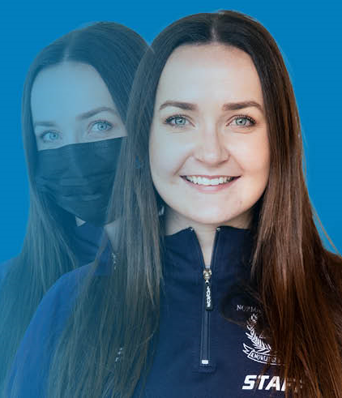
Who are we targeting?
333 schools have been selected to receive targeted support based on the systemic test results, in addition to the 1 100 schools already receiving extra support in the Foundation Phase(FP) since 2022.
The programmes and interventions are targeting the following:
Learners: Approximately 310 000 learners in the FP and 126 000 learners in Grades 4,7,8, 10 and 12.
Teachers: Approximately 10 000 teachers in the FP and 8 900 teachers in Grades 4,7,8, 10 and 12.
Parents: Approximately 28 000 parents will be targeted.

Slide 11
Learner support
Language and Mathematics interventions for Grades 1-3.
Saturday classes for Grades 4, 7 and 8.
Back On Track holiday classes for Grades 7 and 8
Back On Track holiday residential camps for Grade 12 learners.
After-school tutoring programmes.
Subject specific support for Grade 10 and Grade 12 learners.
eLearning platforms like the Maths Curriculum Online programme in the Foundation Phase.
Back On Track Matric Support booklets.
Adjusted timetable for additional time in Language and Mathematics.

Slide 13
Teacher and parent support
Teachers:
Training on the Science of Reading & synthetic phonics approach in the Foundation Phase.
eLearning Mathematics platform training.
Teacher professional development programmes covering the entire curriculum in the Intermediate Phase and Senior Phase.
Subject specific support for Grade 10 and Grade 12 teachers.
Parents/Caregivers
Family numeracy programmes
Educational resources for parents
Skills training workshops to support learning at home.

