Slide 1


THE First 1000 days
J
New neuroscience

Slide 2



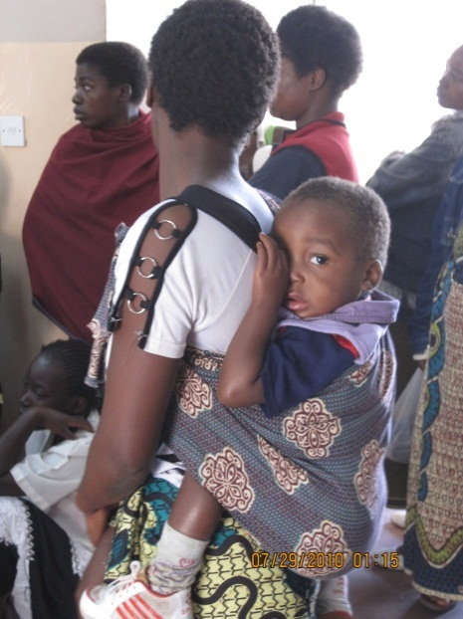
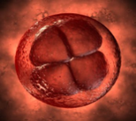
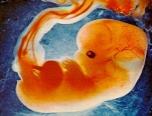

The First 1000 Days “continuum”
270 + 365 + 365 = 1000 ☺
1000 Days
Early postnatal / Infancy
Antenatal
Early Childhood
Conception
Birth
Acknowledgement: Linda Aldair

Slide 3
The First 1000 Days: New Neuroscience
Development of the brain – which is linked to:
Nutrition in the first 1000 days
The mother’s mental well being
Parenting: Quality of relationships / attachment
Stimulation in a safe and protected environment
The four building blocks and impact of early childhood development
The problem of toxic stress
Vulnerability of babies and infants

Slide 4
Nutrition in the first 1000 Days
Optimal development of the brain requires optimal nutrition from conception
However
More than food is needed

Slide 5
Nutrition in the first 1000 Days
Stress and Nutrition interact with each other in the First 1000 Days affecting how the brain and body absorb nutrients and influencing the child’s development – both cognitive and physical

Slide 6
New Neuroscience: The significance of the mother’s mental well being
A fetus or baby exposed to toxic stress can → distorted stress response in later life
This early stress can come from the mother suffering from:
  depression or anxiety
  bad relationship with partner or exposure to violence and abuse
  an external trauma such a bereavement
  food insecurity

Slide 7
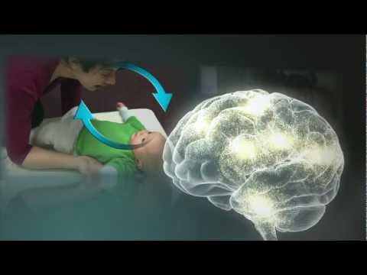

Parenting: Quality of Relationships/‘Attachment’
The baby’s social, emotional and cognitive development is affected by the quality of attachment to the caregiver /s.

Slide 8
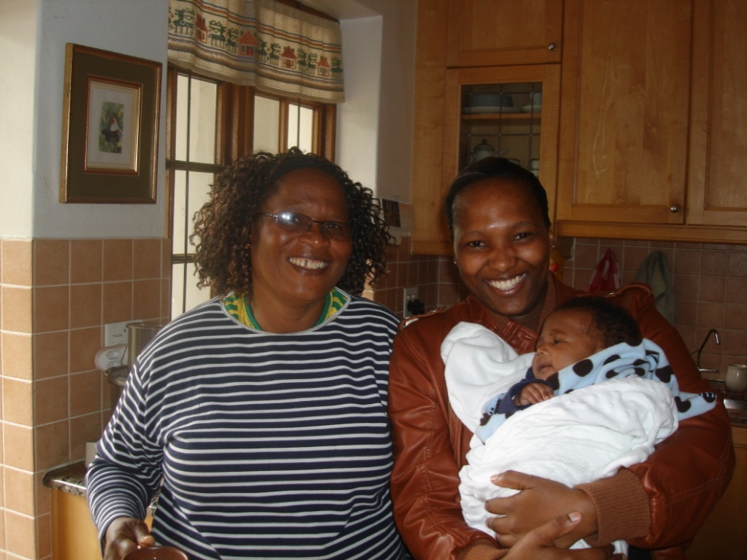
Parenting: Quality of Relationships/’Attachment’
Babies who have warm, loving and responsive care in the first few months of their lives, develop empathy, are able to deal with the emotional and social stresses of life, and have the emotional and mental tools to have good relationships with others.

Slide 9
New Neuroscience:
Stimulation in a safe and protective environment
Infants and babies who are spoken with, played with, and helped to experience the world in a kind and loving way have the mental, social and emotional tools to cope well at school later
It starts with the mother, parents / caregivers → but early childhood learning and development (Educare) is also vital

Slide 10
The Problem of Toxic Stress
Prenatal stress reduces an enzyme which metabolizes cortisol
High level of cortisol in the amniotic fluid
Has a negative effect on infant cognitive development
Toxic stress is defined as the excessive or prolonged activation of the physiologic stress response without the buffering protection afforded by stable, responsive relationships

Slide 11
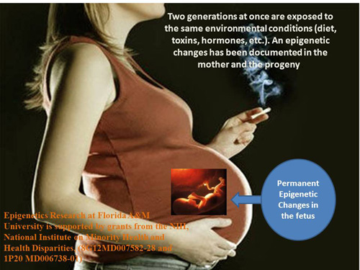
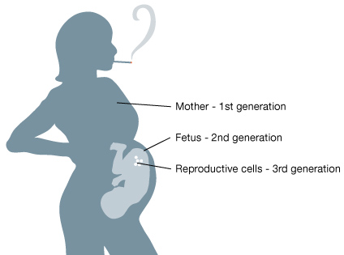
The Problem of Toxic Stress
A toxic intra-uterine
environment causes
pre-natal stress

Slide 12
The Problem of Toxic Stress
The earliest experiences shape a baby’s brain development and have a lifelong impact on the baby’s mental and emotional health
Plasticity
Adaptive Maladaptive

Slide 13
New Neuroscience:
Vulnerability of babies and infants
If things go wrong…
Babies and infants are more vulnerable to abuse and neglect than older children
Abused or neglected children, who don’t have a healthy bond with a caring adult, are at risk of not coping at school, becoming the victim or perpetrator of violence and are likely to struggle later in life

Slide 14
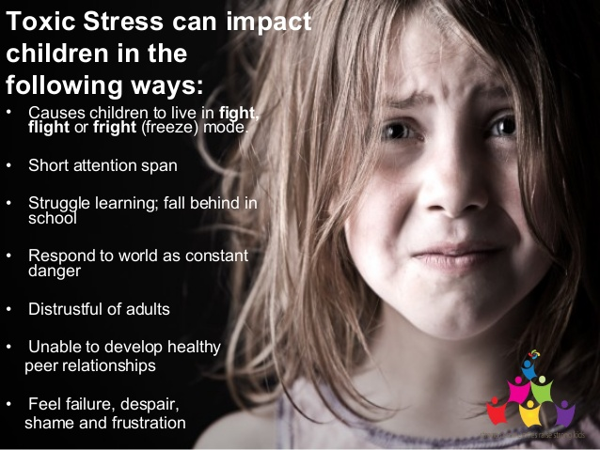
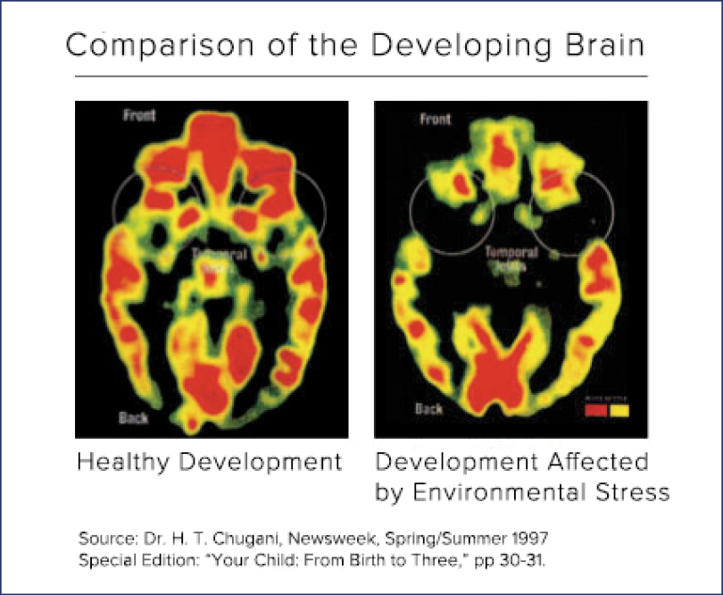
Vulnerability of babies and infants
A fetus or baby exposed to toxic stress can have their responses to stress distorted in later life.

Slide 15
And so the Implications are….
For vulnerable and disadvantaged children =SERIOUS!
Inequity begins during pregnancy and is well established in the first few days and weeks of life
HCW’s need to focused on this crucial time to close the gap that prevents children from their right to develop fully and thrive.
Intersectoral action is critical to optimize brain development, overall health and well being.

Slide 16
In conclusion…..
Many things we need can wait. The child cannot. Now is the time his bones are formed, his mind developed. To him we cannot say tomorrow, his name is today.
Gabriela Mistral

Slide 17
)
Notes:
Ectopic pregnancy: complication of pregnancy in which the embryo implants outside the uterus. Not viable pregnancy; dangerous to mother

