Slide 1
SKILLS DEVELOPMENT
INVESTMENT OF THE WESTERN CAPE GOVERNMENT
Bellville
A Winde

Slide 2
Context
Economic growth has not resulted in significant job creation
Unemployment highest among youth (68.3% of total unemployed)
Forecast predict drop in demand for unskilled labour (-12 000)
Growth predicted to be amongst semi-skilled (+86 000) and skilled labour (+132 000)
In the last Quarter South Africa lost 235 000 jobs – Western Cape gained 18 000 jobs

Slide 3
One of the major challenges facing skills
Future perspectives
We are currently preparing students for jobs that don’t exist, using technologies that have not been invented yet, to solve problems that we are not aware of
The top ten in-demand jobs in 2010 did not exist in 2004
2004
2010
2019

Slide 4
WCG - the employer

Slide 5
WCG employs more then 78,000 people of which the majority are women
Facts & figures
Overview WCG Employees
Key facts
+95%
Senior Managers
374
35%
65%
Middle Managers
1,027
41 %
59%
51094
77421
Manager
Production Staff
1 : 55
272
26327
Male
employees
Female employees
Total number of employees
8692 vacant positions

Slide 6
Human Resource Development
To ensure that our people resources are fit for their intended purposes
Developing the Pipeline
Improving Service Delivery
3000+ Bursaries
Health, teaching, social development
561 Internships
Workplace experience
PAY Learners
759 matriculants of previous year
1 year experience in provincial government
Retention Rate (70% for employment or further study opportunities)
BPO – Partnership to take up PAY Learners
766 Bursaries
Up-skilling programmes
Provincial training institute programmes
Other short courses based on individual performance plans
Total Investment
of WCG
R442 537 000

Slide 7
WCG –creating an enabling environment

Slide 8
Supply meets demand
Artisan Development
Key partnerships with industry and FET colleges to train and place
500 artisans and 100 trainers in metals, marine, engineering, hospitality, construction,
Youth in Construction
270 unemployed youth
Artisans training (40 increasing to 105 in 2013/14)
Tourism
Career awareness (965), job shadowing (118)
Service excellence (325)
Bursaries (45), FET skills (400)

Slide 9
Supply meets demand
Agriculture
Accredited skills training programmes (434)
Learnerships FET (102)
Short skills courses (2022)
Bursaries (22)
Career Awareness
Masakh’iSizwe
220 bursaries in engineering and built environment
Partnerships with 14 companies for funding and placement
CapaCITI 1000
90 Business analysts
Emerging farmers in Aquaculture (12)

Slide 10
Workplace Experience Opportunities
Text slide with title boxes in colour horizontal and flow triangle
Work and Skills
Access package for 750 Unemployed matriculants / FET graduates
Job readiness training
6 months work placement within expanding sectors
Stipend paid by DEDAT with strong business partnerships who top-up stipends
Further funding secured through DBSA to expand numbers
EPWP
Programme by the public sector body to use expenditure on goods and services to create work opportunities for the unemployed
Target for 2012/13:
72 142 (work opportunities) = 35 181 (full-time equivalent)
Youth Development Programmes
Chrysalis Youth Development
180 out of school youth in residential training, 100 parents in 9 parenting workshop,3 leadership courses- R283 643,40.
Second round funding- 540 students, 20 leaders, 5 municipalities- R1 434 000,00
Also funding of agencies involved in skills development

Slide 11
Facilitation of partnerships
Investment in skills in the Western Cape
Development Bank of South Africa – Jobs Fund
South African Renewable Energy Training Centre
Work and Skills – R39m
CapaCITI 1000 – R12m
Artisan Development – R13.5m
CPUT / DHET / GIZ – R105m
Collaboration
Key Fact
FET Colleges / SETA Partnerships
CATHSSETA
West Coast FET College and Construction SETA (CETA) – R4.5m
4 year MOU agreement entered into between DEDAT and the CATHSSETA for collaboration on strategic Tourism Arts and Entertainment projects – R10m over 3 years

Slide 12
WCG – paving the way

Slide 13
EDP as a Transition Arena Coordinator
Govern-ment
Basic Education
CWP, EPWP
PAY
Jobs and Skills Program
Awareness
Assessment
Bridging
Placement
Intermediary organisations
Business
One Cape 2040
(plan for society)
Internships
New enterprises
Skills development
Investment
Innovation
Research
FETs
Knowledge-based
Institutions
Civil
Society
Transition arena
Internships
Social enterprises
Implementing agents
Labour
Skills
Unemployment
Learnerships
SETAs
Productivity

Slide 14
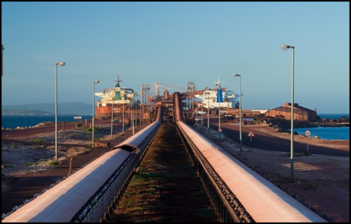
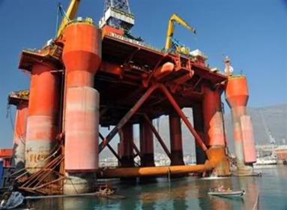
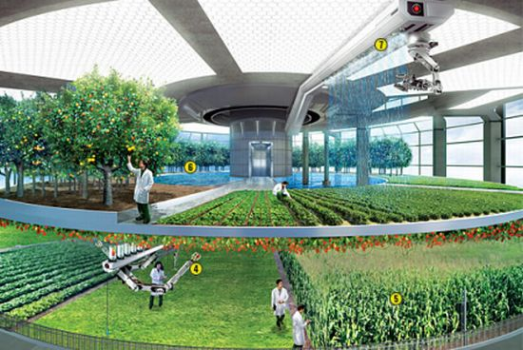
Opportunities
Catalytic Interventions
Economic growth driven by public investment in infrastructure. Major projects planned:
Saldanha Industrial Development Zone and SIP5
Broadband Strategy
Design Strategy
Green Economy
Regeneration
Understand implications for skills development and develop skills plan
together

Slide 16
MEC Alan Winde
Finance, Economic Development and Tourism
+27 (0) 21 483 3531
Alan.Winde@westerncape.gov.za

