Slide 1
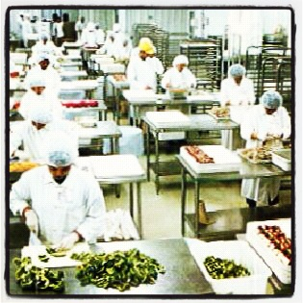
PREMIER’S COUNCIL ON SKILLS
ENTREPRENEURSHIP
Keet van Zyl
www.knifecap.com @KeetvZ @KnifeCap

Slide 2
Business Building

Slide 3
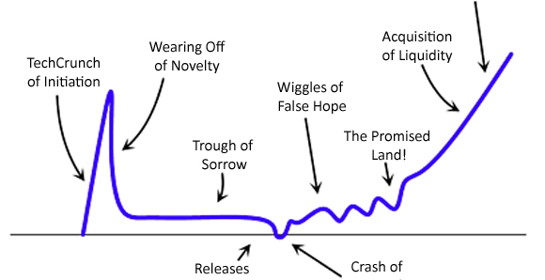
The Startup Curve
Path to
Sustainability
Reality
Check
SME
Initial
Enthusiasm
Growth & Scale
Execution
Skills,
Networks,
Funding
Lack of
Traction
STARTUP
Crash of
Ineptitude *
Opportunity
Cost
* Ineptitude: Unskillfulness
resulting from a lack of training

Slide 4
The Startup Curve
Path to
Sustainability
Reality
Check
SME
Initial
Enthusiasm
Growth & Scale
Execution
Skills,
Networks,
Funding
Lack of
Traction
STARTUP
Crash of
Ineptitude *
Opportunity
Cost
* Ineptitude: Unskillfulness
resulting from a lack of training

Slide 5
Challenges of a Small Business
Limited Resources
2-5 people
Networks
Red Tape
Bootstrapped infrastructure
Short timeframe to make it work
Focused on product, not customer
Access to Funding
Funded by ‘3Fs’
(Friends, Family & Fools)
Technical minds
but limited
business skills
Competitive environment
Mentorship
Support Services

Slide 6
Why Startups Fail ? Startup Genome Project
At the core of any successful business:
1) Good Product / Service
2) Large Market for that Product
This enables the Startup to grow/ scale (and become sustainable)
To scale properly it must balance growth of 5 core dimensions:
1) Customers
2) Product
3) Team
4) Business Model
5) Funding
Business Skills
Dominant reason for Startup failure?
→ Disproportionate scaling of one or more of those dimensions!

Slide 7
Skills required to grow from Small to Medium Enterprise
Balanced scaling/ growth of Business
Business/ strategic planning
Financial management
Sales & Marketing insights
HR & employment assistance
Corporate governance
Product development & pricing strategies
Access to legal & IP services
Creation of business networks
Market access
International expansion enablement
Funding options / Facilitation of funding
Skills:
Vocation vs. Business
Success can be ‘Engineered’:
Training, Mentorship, Experience, Funding, Support Services
SKILLS/
KNOWLEDGE
NETWORKS
FUNDING

Slide 8
Game Changers for Growth of Western Cape SME’s
Entrepreneurship Training
Co-investment/
Fund Raising Support
Facilitate Ease of
Doing Business
Western Cape Growth Equity
Fund ?
Build Western Cape
Entrepreneurial Ecosystem
Early-Stage
Investment
Incentives
Catalyse
Business
Accelerators
The WC needs to accelerate
the successful development of scalable SME’s
to position them to be sustainable, attractive to investors
and able to take advantage of growth opportunities

Slide 9
THANK YOU
@KnifeCap
@AngelHubZA
Keet van Zyl
www.knifecap.com
keet@knifecap.com
@KeetvZ

