Slide 1
Western Cape Education Department
Broadband: e-Vision for e-Education e-Learning and e-Administration
February 2013

Slide 2
From Broadband to eEducation
WCG Broadband initiative
Schools’ Broadband connectivity by 2014
Implications for eEducation
Vision for eTeaching and eLearning (2014-2024)
Every Teacher and every learner will have instantaneous, real-time, free access to digital learning resources
Notes:
Not for Admin
Enhance Learning outcomes
Allow learners to fly…

Slide 3
Vision
WiFi LAN in all schools
Handheld devices for all learners
Access to central repository of digital content for eTeaching and eLearning
Simultaneous live lessons broadcast from best classrooms
Online simultaneous assessments
Etc, etc….
Notes:
Reality- great divide
Vision imagines:
metamorphosis of traditional teaching, learning and environments into e-Teaching and e-Learning and virtual learning environments,
increasing availability of digital resources and systems,
emergence of new ways of educational engagement.
Propelling WCED into a new e-Learning era.

Slide 4
Progression Map
From: bound controlled classrooms
To: always connected, anytime, anywhere access
From: consumer of digital resources
To: Designer – builder - creator - sharer
From: Passive learning
To: collaborative - self paced – self determined learning
From: Traditional teaching
To: Supporting – mentoring – facilitating - e-pedagogies
From: Propriety software
To: Freeware - learning objects - Apps
From: Wired LAN
To: Wireless LAN - WAN - Cloud
From: one-to-many
To: one-to-one; many–to-many; networked teaching /learning
From: Computer labs
To: Classroom technology – Laptops - Mobile devices - Hand held devices
Notes:
Key: Systemic Change Management – everyone is affected!

Slide 5
Timeline
2012
2014
2015
2017
2020
2022
2030
29 000
e-Teaching
Use of digital resources to enhance teaching/learning
e-lessons
e-assessment
Extended reach using technologies
e-mentor/support
e-Learning enabler
Use of technology to present lessons
Blended f2f/on-line lessons
1 000 000
e-Learning
Online lessons / assessment & collaboration/communication
Self-paced / individualised mentored learning
Technology use for traditional tasks
Use of digital resources to support learning
Collaborative learning
CAPS
Curriculum / Education
Digital teaching & learning resources
Integrated pedagogies
Propriety software
Traditional models
Freeware
Learning objects
Evolving methodologies
Online modules
Self-determined
e-Learning
Networks
e-Education System
WAN
Broadband
LMS
Wireless LAN
Cloud computing
Internet
Wired LAN networks
Wireless networks
1455 schools
Environment
Computer labs
Traditional classrooms
Computers in classrooms
Modified classrooms
Mobile devices in classrooms
Multi-media hubs
Reconfigured classrooms
Mobile hand-held, WIFI enabled devices anywhere
CEMIS/SAMS
e-Administration
Online/Offline secure SAMS – focus on classroom/central policy driven curriculum e-admin
Online SAMS integrate with National – focus on school finance management/ e-capacity building
National Online SAMS – real-time data used for planning at school/Districts/Provincial/National with built in governance
CEMIS/SAMS integration
Online business transacting – focus on data quality
Notes:
45 000 computers in schools
2 500 laptops
4 800 data projectors
2 500 interactive white boards

Slide 6
Skills requirements
Schools, teachers, learners must have access to systems, services, digital content and support:
Ability to service and maintain 1 000 school LANs
Need for supply and maintenance of equipment and devices (laptops/tablets)
Development and maintenance of digital resources
eResources, eTextbooks and eReaders
Need for/development of digital platforms
Training for teachers and learners

Slide 7
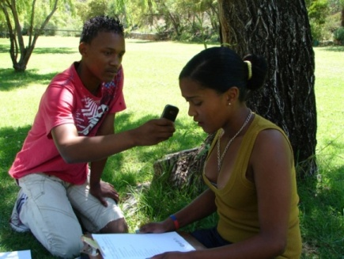
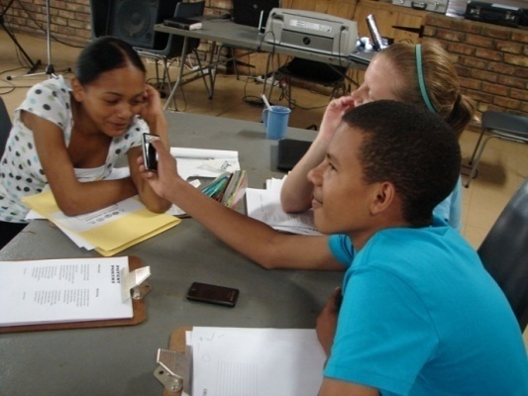
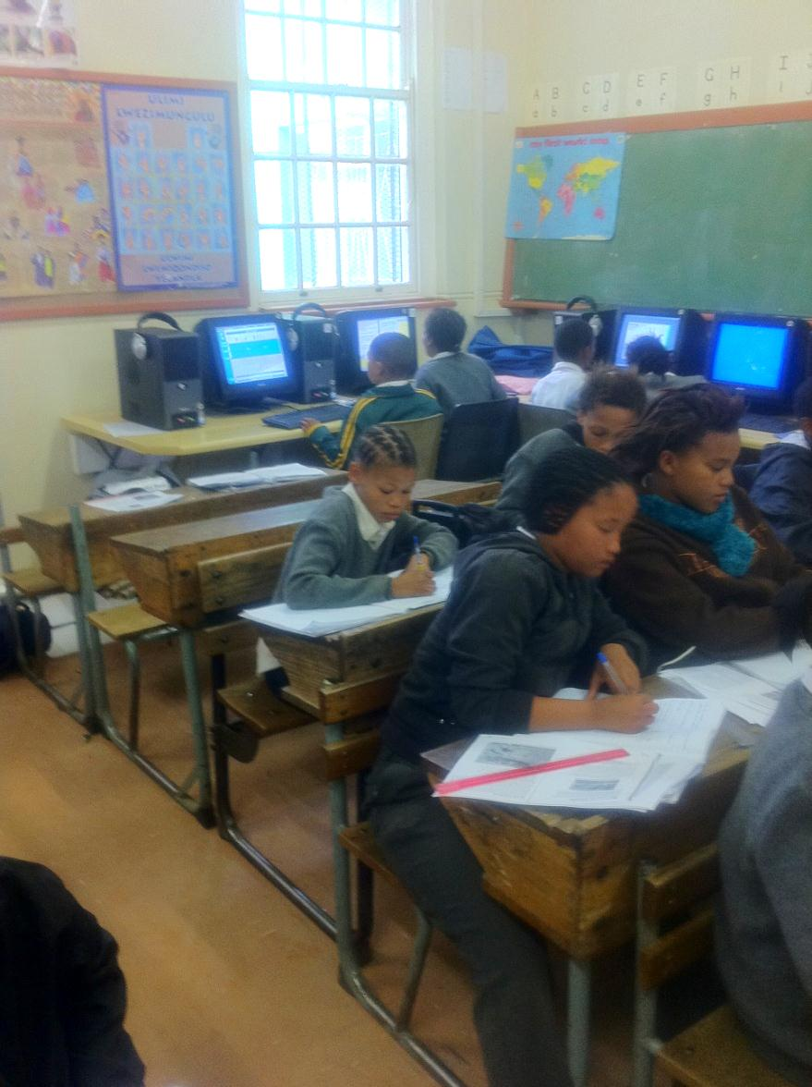
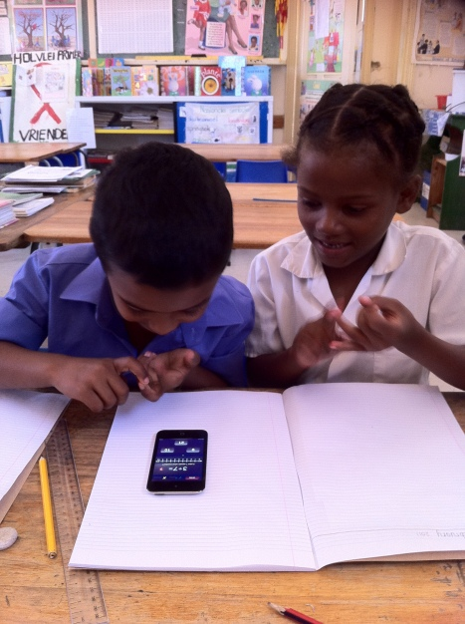
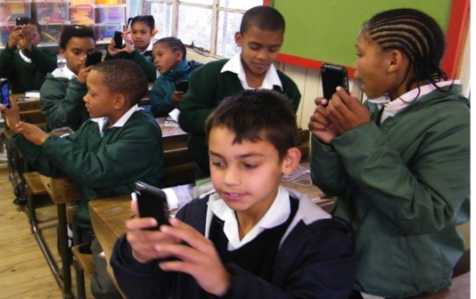
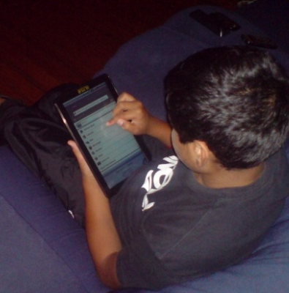
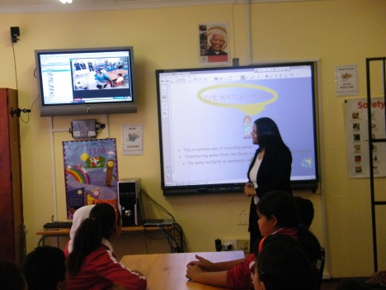
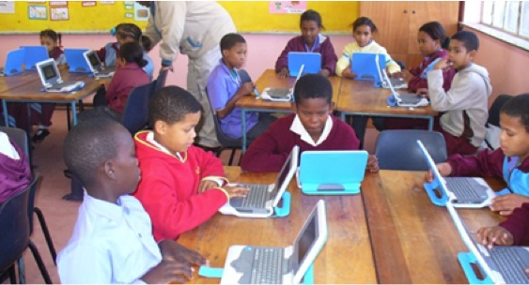
Classroom of the Future – for ALL
Notes:
Broadband connectivity is the enabler
Opportunities to revolutionise learning and teaching in our province/country
Once again we are embarking on an exciting, ground-breaking and visionary initiative
Need of a variety of skills to ensure successful development, roll-out and sustained support.
THANK YOU

