Slide 1
FAECES ATTACKS: PERPETRATOR REPORT
WESTERN CAPE PROVINCIAL CABINET

Slide 2
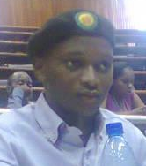


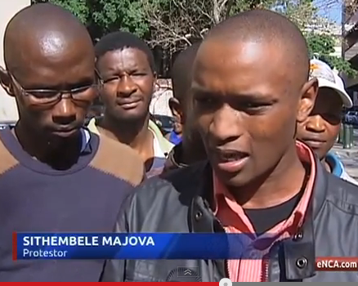
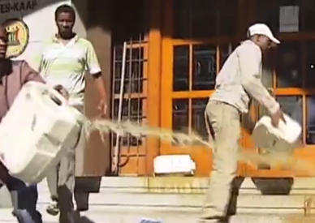
Faeces attacks perpetrators:
Sithembele Majova
ANC branch chair, ANCYL member
Known Faeces Attacks
5 August 2013, Faeces dumped on Parliamentary Legislature, 7 Wale St, Cape Town; Co-ordinator and spokesperson of Informal Settlements Task Team. Studied Accountancy at UWC.
“We will no longer march for the sake of marching. Now we will show our anger. And different people have their own ways of demonstrating their anger.” Quoted in Daily Voice, 6th August 2012. “If our demands are not met we will make the province ungovernable,” said Majova. Quoted on westcapenews.com, 27th August 2013.

Slide 3
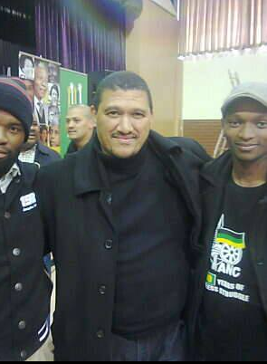
Faeces attacks perpetrators:
Sithembele Majova
ANC branch chair, ANCYL member
Known Faeces Attacks
5 August 2013, Faeces dumped on Parliamentary Legislature, 7 Wale St, Cape Town; Co-ordinator and spokesperson of Informal Settlements Task Team. Photo taken with Deputy Minister of International Relations and Western Cape Provincial leader, Marius Fransman. Uploaded to Facebook 5th August 2013.

Slide 4
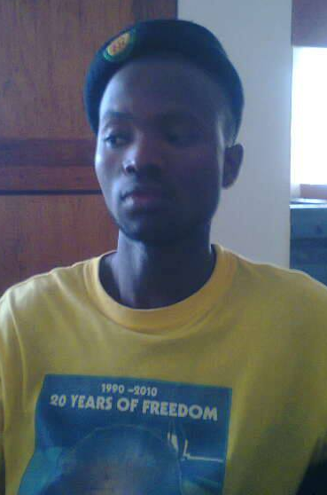
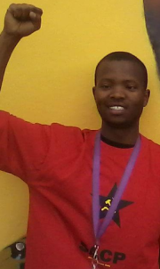

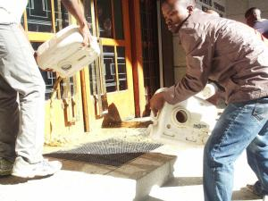
Faeces attacks perpetrators:
Sibusiso “Mqithi” Zonke
ANC, ANCYL Branch Secretary, SACP
Known Faeces Attacks
Sunday 28th July 2013, N2 highway attacked near Mew Way turnoff.
Also arrested on 11th June 2013 at Esplanade Station in attempted attack on Civic Centre.
5 August 2013, Faeces dumped at entrance of the Parliamentary Legislature, 7 Wale St, Cape Town.
23 old, 3rd year law student at UWC. Lives in residence. Appeared “anonymously” on cover of Cape Argus, 27th August 2013.

Slide 5
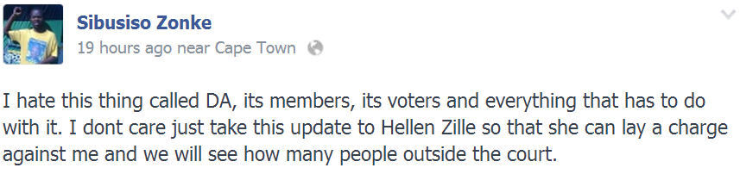
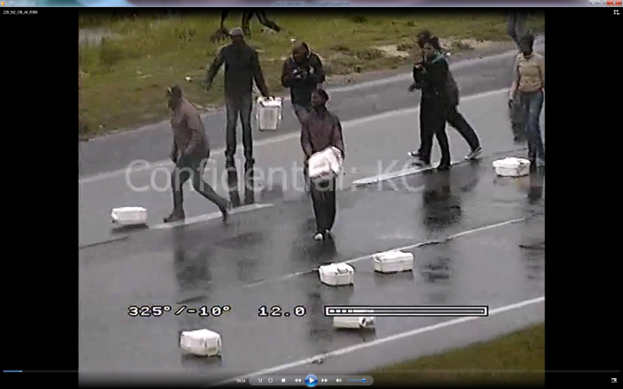
Faeces attacks perpetrators:
Sibusiso “Mqithi” Zonke
ANC, ANCYL Branch Secretary, SACP
Known Faeces Attacks
Tuesday 6th August 2013, DA Community Help Desk, Blue Hall, Site C, Khayelitsha.
Cllr Steven Vuba (DA) is hit with faeces in the attack.
Wednesday 7th August 2013, N2 attacked. Faeces and burning tyres used. Truck hijacked.

Slide 6
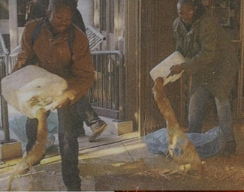
Faeces attacks perpetrators:
Sibusiso “Mqithi” Zonke
ANC, ANCYL Branch Secretary, SACP
Known Faeces Attacks
Saturday 27th June 2013, Faeces dumped at Belville Civic Centre.

Slide 7
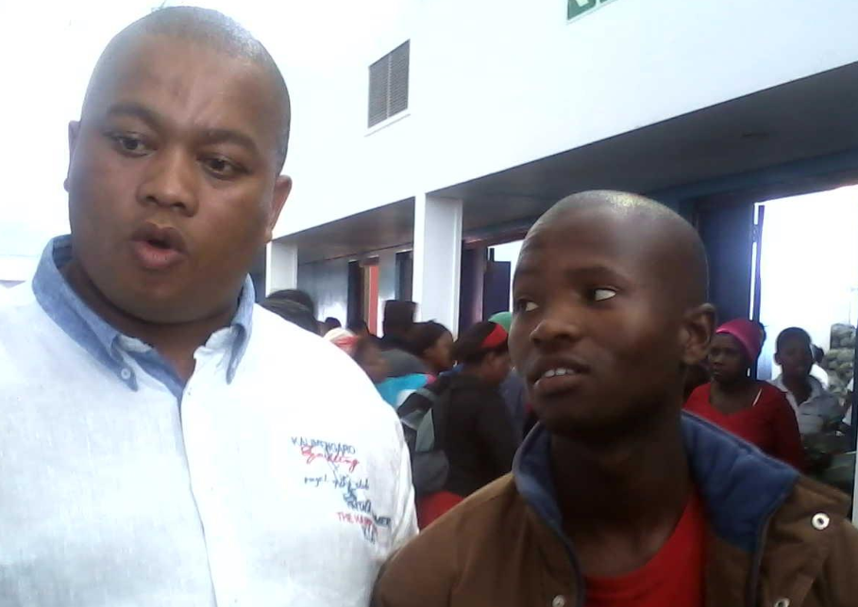
Faeces attacks perpetrators:
Sibusiso “Mqithi” Zonke
ANC, ANCYL Branch Secretary, SACP
Known Faeces Attacks
With Western Cape ANC Provincial Secretary, Songezo Mjongile, OR Tambo Hall, Khayelitsha. Uploaded 5 March 2013.

Slide 8
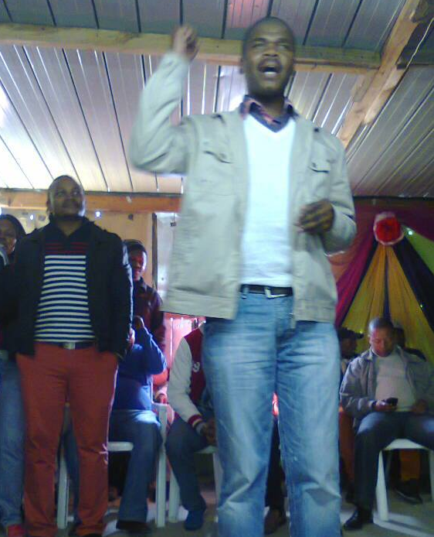
Faeces attacks perpetrators:
Sibusiso “Mqithi” Zonke
ANC, ANCYL Branch Secretary, SACP
Known Faeces Attacks
With Ward 90 ANC Councillor, Luvuyo Hebe, Khayelitsha. Uploaded via mobile 21 July 2013. Bongani Ncombolo (appears in this document) at left.
Cllr Hebe (ANC), was arrested for public violence on 2 August 2012, during ungovernability riots.

Slide 9
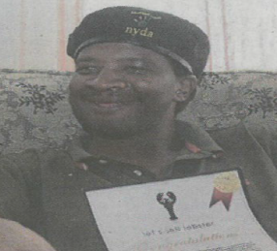
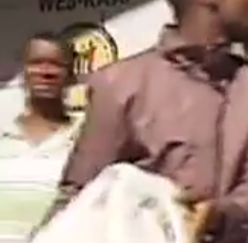
Faeces attacks perpetrators:
Nangamso “Kavin” Tshutha
ANC, ANCYL
Known Faeces Attacks
Sunday 28th July 2013, N2 highway near Mew Way turnoff.
5 August 2013, Parliamentary Legislature, 7 Wale St, Cape Town;
“Nangamso Kavin 3 August via Mobile IM BORED 2 DAY I FEEL LYK I WANNA THROW HUMAN FEASES ON N2 OR ON PROVINCIAL GORVEMENT BUILD JUST 2 UNRREST METRO-POLICE I SEE THAT THEY ARE RESTING 2 DAY”

Slide 10
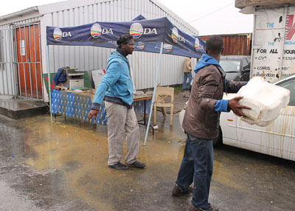
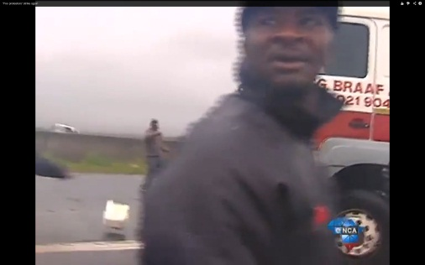
Faeces attacks perpetrators:
Nangamso “Kavin” Tshutha
ANC, ANCYL
Known Faeces Attacks
Tuesday 6th August 2013, DA Community Help Desk, Blue Hall, Site C, Khayelitsha.
Cllr Steven Vuba (DA) is hit with faeces in the attack.
Wednesday 7th August 2013, N2 attacked. Faeces and burning tyres used. Truck hijacked.
Lives with his parents in formal housing, plans to start restaurant with Bongile Zanazo.

Slide 11
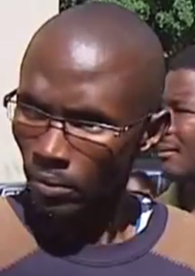
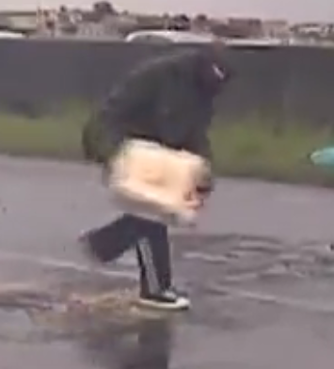
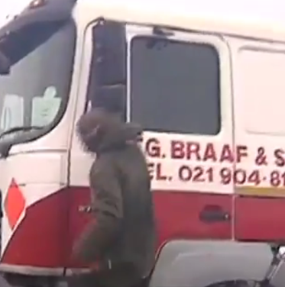
Faeces attacks perpetrators:
Khaya Kama
ANC
Known Faeces Attacks
Saturday 27th June 2013, Faeces dumped at Belville Civic Centre.
Wednesday 7th August 2013, N2 attacked. Faeces and burning tyres used. Truck hijacked.

Slide 12
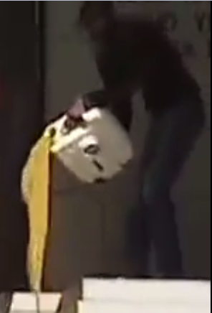
Faeces attacks perpetrators:
Khaya Kama
ANC
Known Faeces Attacks
5 August 2013, Parliamentary Legislature, 7 Wale St, Cape Town;

Slide 13
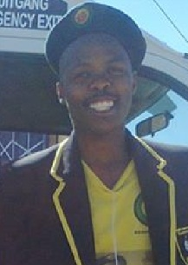
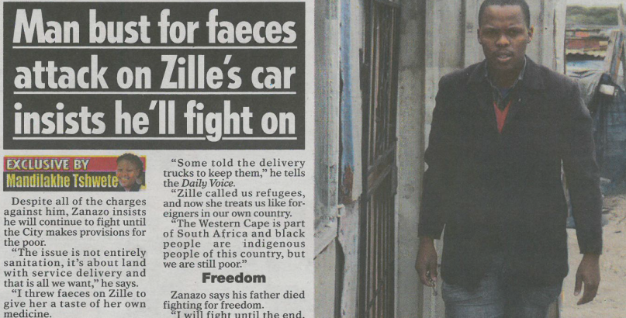
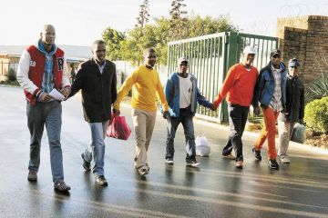
Faeces attacks perpetrators:
Bongile Zanazo
ANC, ANCYL
Known Faeces Attacks
4th June 2013, Faeces dumped at community hall in Khayelitsha at Green Economy event.
Arrested at scene, although docket later went missing. Also arrested on 11th June 2013 at Esplanade Station in attempted attack on Civic Centre.
25 June 2013, Cape Town International Airport

Slide 14
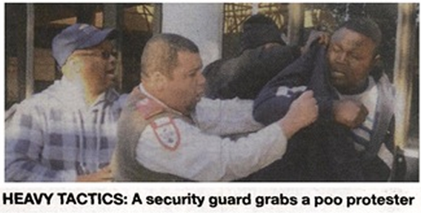

Faeces attacks perpetrators:
Bongani Ncombolo
ANC, Ward 40, Ward Committee Youth Rep
Known Faeces Attacks
27 June 2013, Belville Civic Centre
(Also arrested at Esplanade Station, 11 June 2013) Nyanga Community Leader “That’s why you see the action at the airport today, it was planned. We targeted the airport because we know that the airport is very much important in terms of the Western Cape economy”, video interview with Die Burger, 25th June 2013.

Slide 15
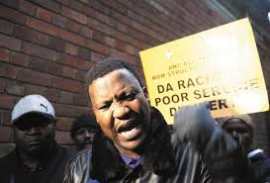
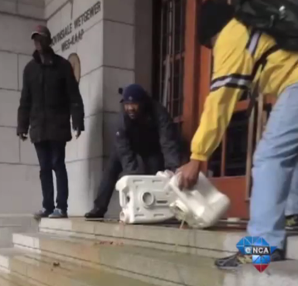
Faeces attacks perpetrators:
Andile Lili
Former ANC City Councillor, ANCYL leader
Known Faeces Attacks
3 June 2013, Parliamentary Legislature, 7 Wale St, Cape Town;
25 June 2013, Cape Town International Airport

Slide 16
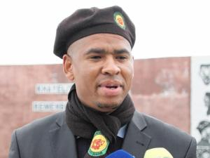
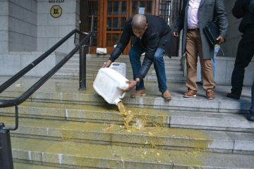
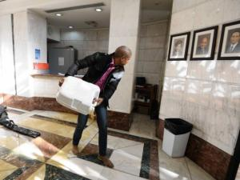
Faeces attacks perpetrators:
Loyiso Nkohla
ANC City Councillor, ANCYL leader
Known Faeces Attacks
3 June 2013, Parliamentary Legislature, 7 Wale St, Cape Town;
11 June 2013, Protea Assurance Building, Greenmarket Square

Slide 17
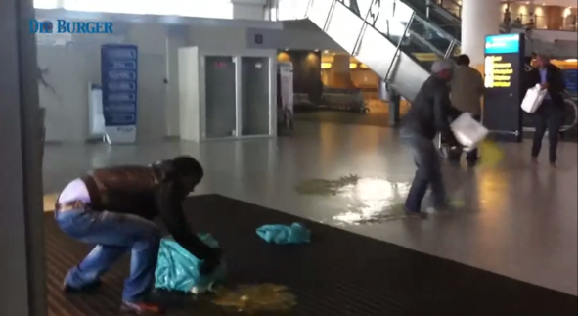
Faeces attacks perpetrators:
Loyiso Nkohla
ANC City Councillor, ANCYL member
Known Faeces Attacks
25 June 2013, Cape Town International Airport
“All we want is a positive response (to our ultimatum),” Nkohla tells the Daily Voice. “But if we do not get that, we will not back down or retreat from the statements we have made to make this province ungovernable. “It is those people who burn traffic lights that we want on our side on the day.”; quoted in Daily Voice, Aug 6 2012.

Slide 18
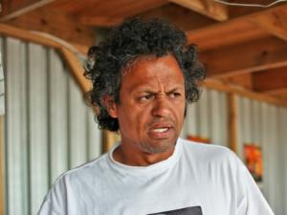

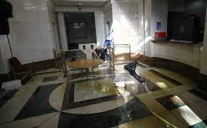
Faeces attacks perpetrators:
Mario Wanza
UDF Leader
Known Faeces Attacks
11 June 2013, Protea Assurance Building, Greenmarket Square
“The police can arrest us but we are still going to fight. We won’t back down until we get answers from Zille,” Nkohla said shortly after a group of them, including Proudly Manenberg’s Mario Wanza, spilled the contents of portaloo containers on to the ground, to show Zille that “we will find other ways to carry our message across”. Reported in Cape Argus June 11th 2013.

Slide 19
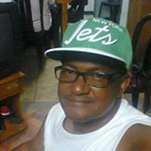
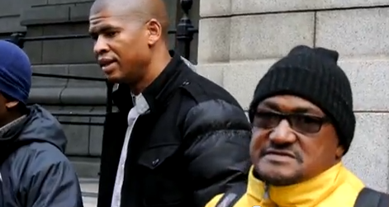
Faeces attacks perpetrators:
Sulyman Stellenboom
UDF Leader
Known Faeces Attacks
3 June 2013, Parliamentary Legislature, 7 Wale St, Cape Town;
Stellenboom said yesterday’s actions were the first step. The UDF was mobilising more people to join their campaign against bucket toilets. Reported on westerncapenews.com, 4th June 2013.

Slide 20
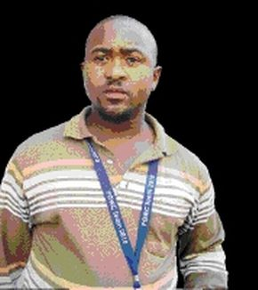

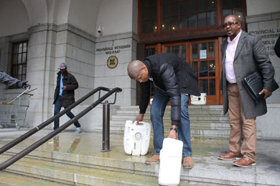
Faeces attacks perpetrators:
Songezo Mvandaba
SANCO Chairperson
Known Faeces Attacks
3 June 2013, Parliamentary Legislature, 7 Wale St, Cape Town;

