Slide 1
Top Yard
“New Life in the east CBD”
PROVINCIAL REGENERATION PROGRAMME
INVESTOR CONFERENCE
26 March 2014

Slide 2
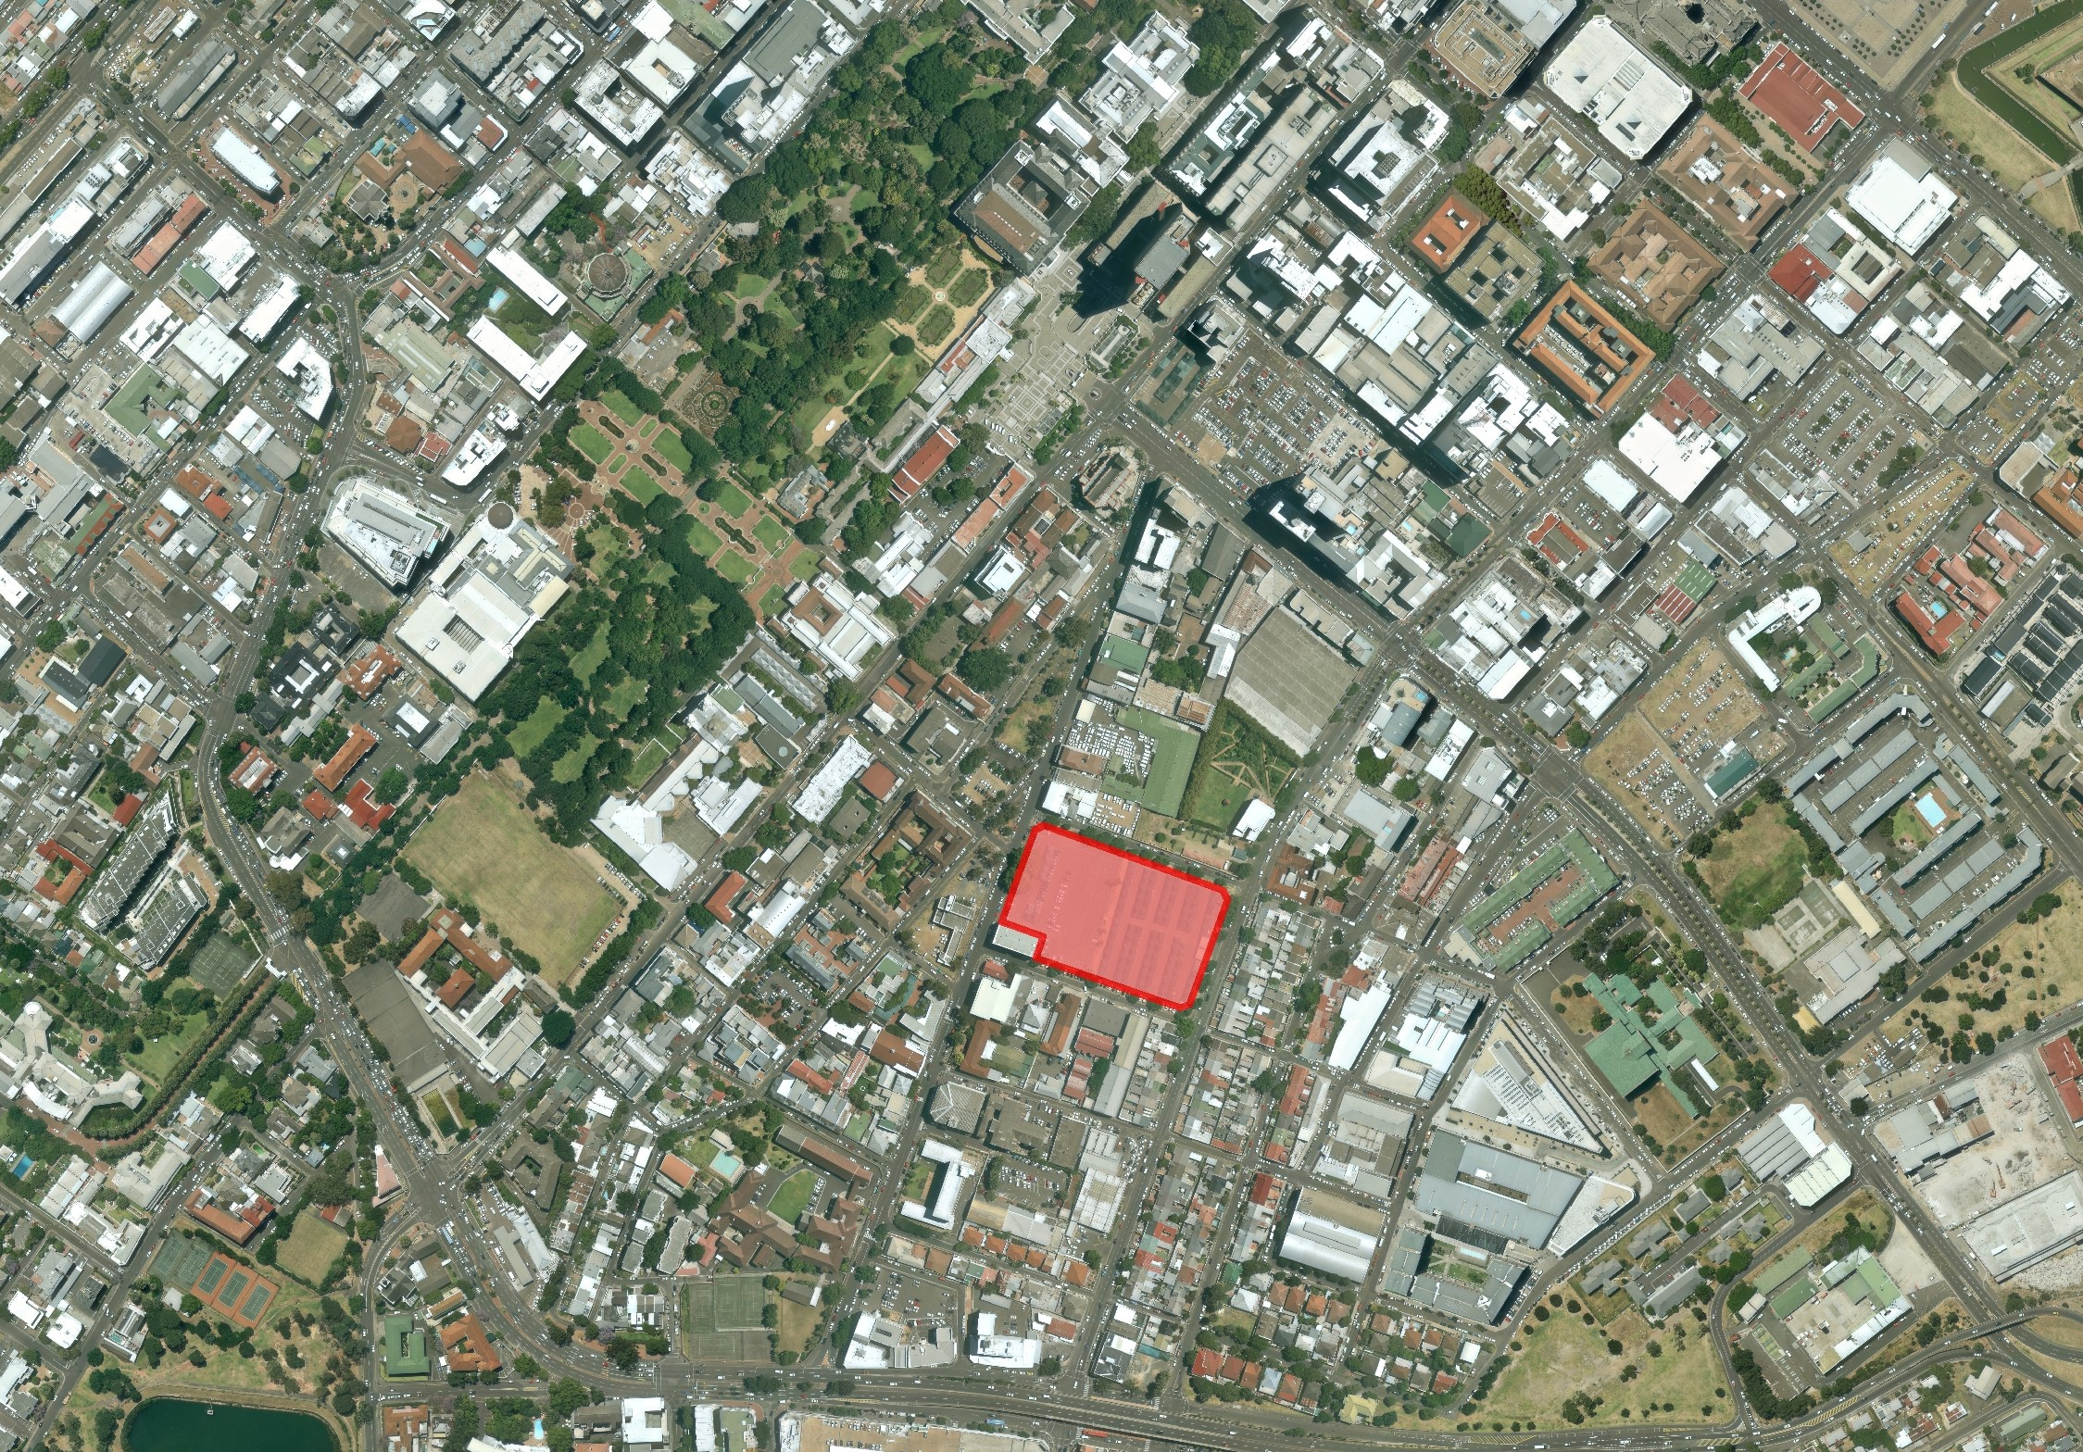
Contents
Introduction
Context and Location
Zoning and Ownership
Heritage and Environmental Status
Vacant Possession
Summary

Slide 3
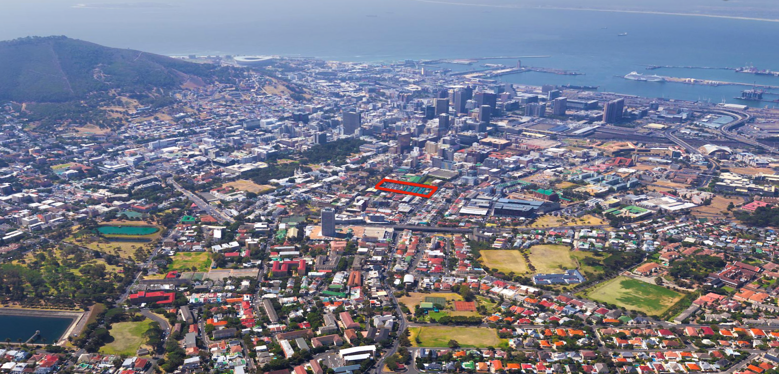
Top Yard
New Life in the east CBD
Introduction
Erf 96174, 85 Hope Street
Erf size: 11,621m²
Zoning: MU2
Est Bulk: 46,484m²
Notes:
Good morning , as mentioned my name is CL and it is a privilege to introduce Top Yard project to you today.
I will begin by providing a broad site overview then working into more detail related to the property.
Some headline information in case you are in anyway familiar with the site.
Erf 96174 otherwise known as Top Yard, is a prominent site located in the east part of the City and is 11,621m2 in extent.
Street adress is 85 Hope street, and is bounded by Buitenkant, Hope, Glynns streets.
The zoning is Mixed use 2 and we are dealing with a potential 46,864 m

Slide 4
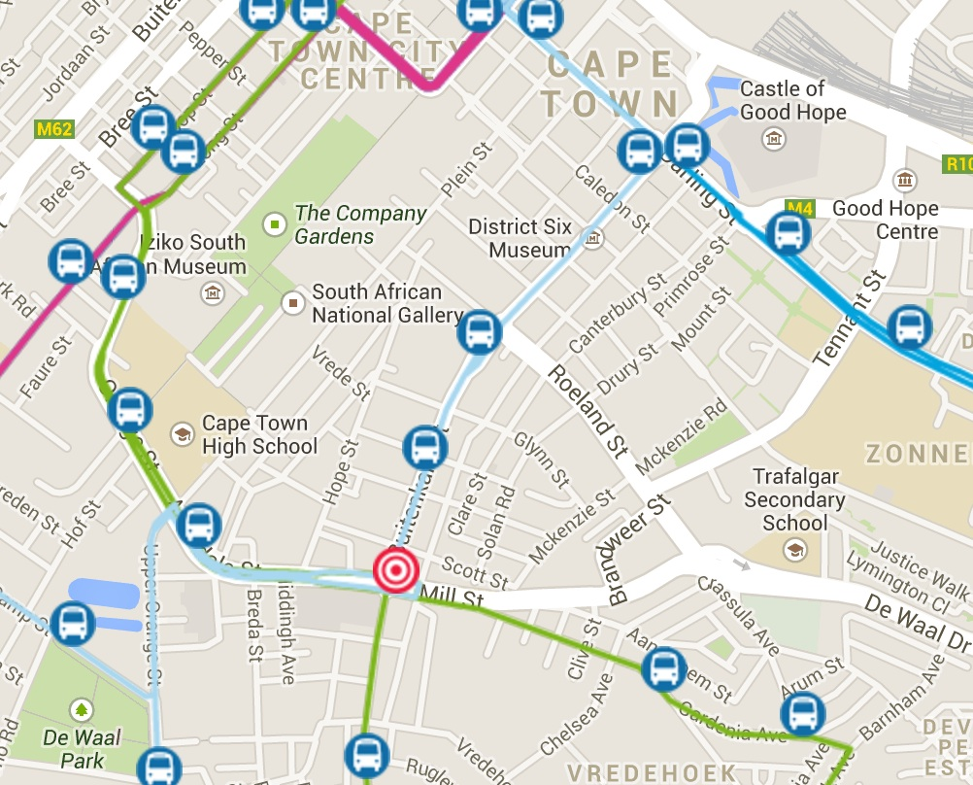
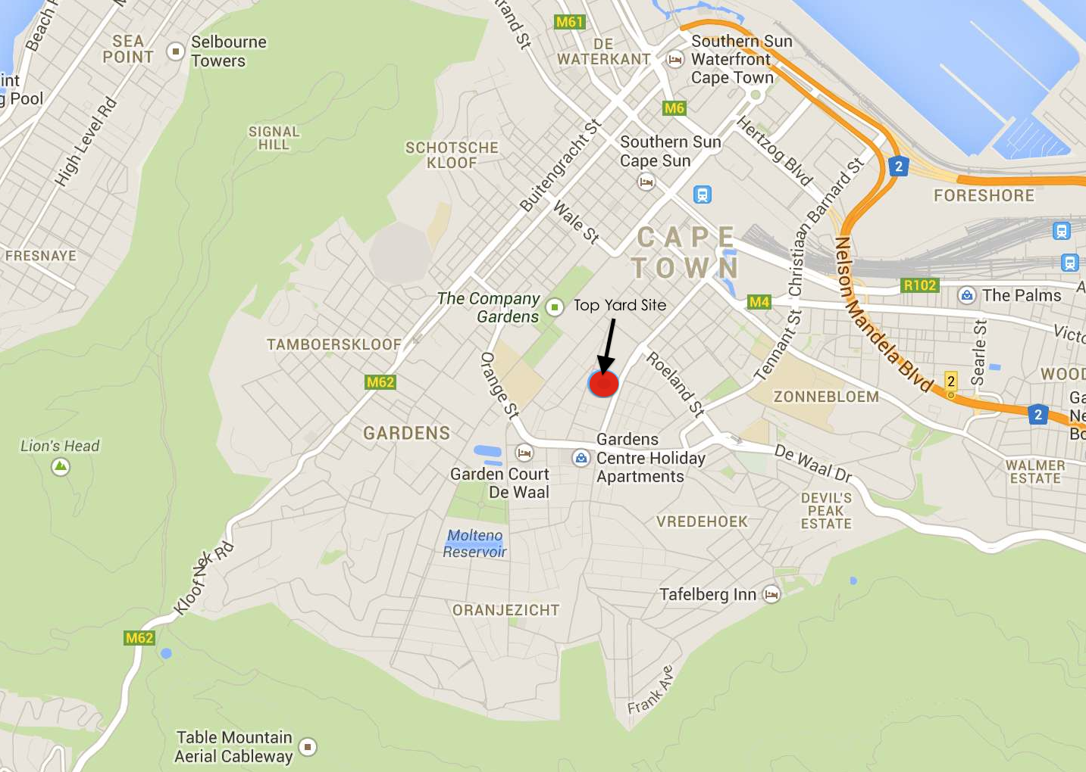
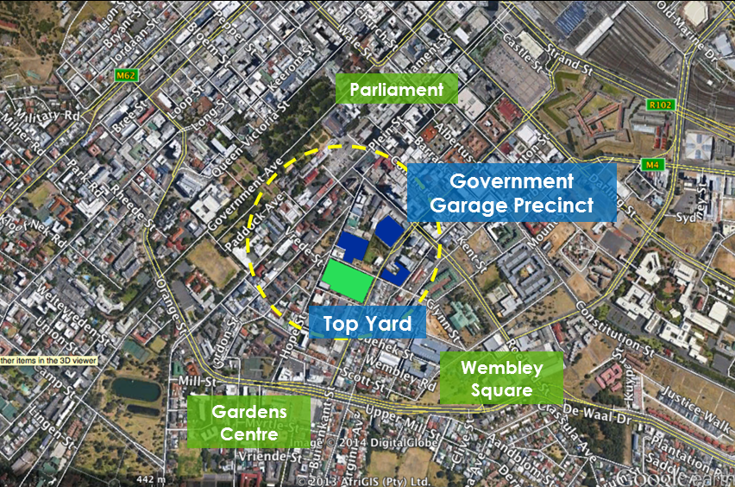
Top Yard
New Life in the east CBD
Context & Location
Conveniently located in the east part of the CBD
Part of the Government Garage Precinct
Accessible to transport interchanges and routes:
    N2 via De Waal Drive
    MyCiti Bus stop 103 route next to Top Yard
    Gardens Centre MyCiti Station and the 101 & 102 routes within 5 min walk
Notes:
In terms Top Yards location it is situated in the East Part of the CBD. This part of the CBD has seen some development activity (Gardens Lifestyle Centre, Wembley Square) however is still under utilised and provides a tremendous opportunity for urban upliftment in this part of the City.
It is worth noting that Top Yard is one of four properties in the area that are more broadly referred to as Government Garage precinct. DTPW is in process of completing a Precinct Plan that will encompass all four properties.
The precinct plan is expected to be complete by the end of July and will amongst other information provide information for Top Yard that will:
The advantage of this is ensure we maximise the potential of the four sites and:
1. Assist developers ensuring items such as Bulk services, geotech, zoning, heritage, environmental and the useable bulk have been considered
2. Assist in smoothing the approval process at a Site development stage by engaging with the CoCT at this initial stage
The is wonderful Transport Accessibility options from this site both into the CBD and to road networks via the N2. 3 MiCiti routes are witihin a 5 minute walking distance with the 103 bus stop next to the site and the Gardens station some 300m away.

Slide 5
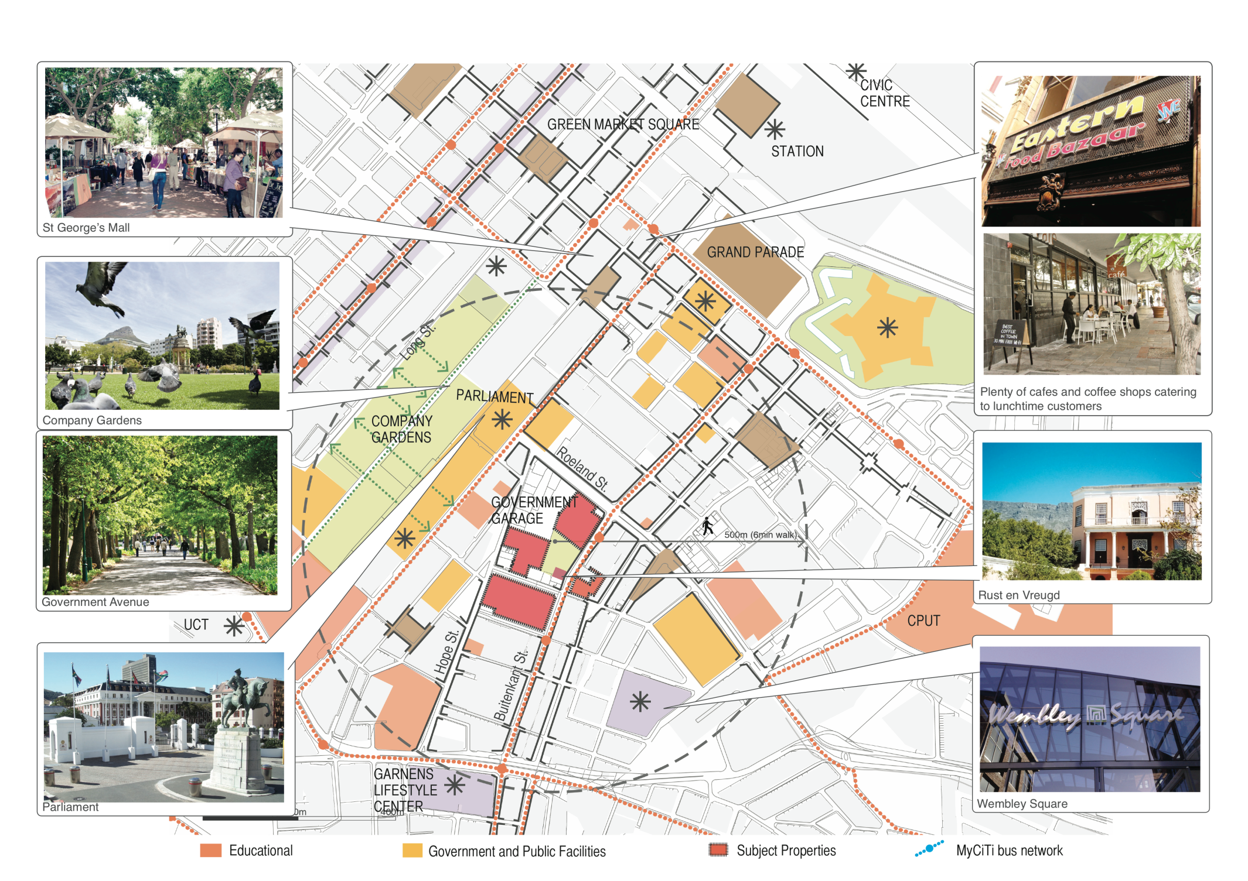
Top Yard
New Life in the east CBD
Notes:
In looking to the context of Top Yard a few notable points can be highlighted.
- The area is not saturated with office use but rather is starting to present itself as a popular area for Government and Educational uses: Examples include Parliament , CPUT, CUT Hidding Campus, Cape Town High, Harold Cressy, French School,
- Fair to say is that there is also proximity
The Diagram here highlights the most prominent 3 sites, the fourth being robbie-nurrock located adjacent to the Rust en Vreud Gardens. It is the DTPW’s intentionto develop all of these properties over time, the first of which is currently Top Yard.
The sites context does paint a picture of an area that is not dominated by office space but one where there are several educational facilaites (CPUT, French School, Cressy, and more recently City Varsity), Government departments (Parliament being the obvious) and residences, fine grain runnign along the buitenkant street and several larger residential blocks in the area. The obvious office space in the area are found at Wembley square or towards the CBD on commercial st.
The nearest retail does lie at Gardens centre with Wembley square
It is also currently understood that clearly importance to development in this area is access to green space, linking in with the public transport running along Buitenkant street and the need for more pedestrian friendly routes into the City.

Slide 6
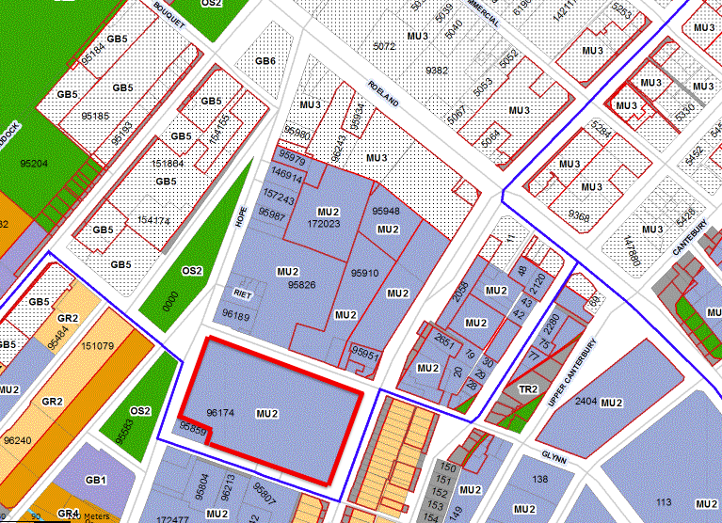
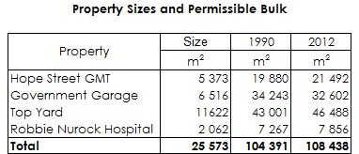
Top Yard
New Life in the east CBD
Zoning & Ownership
Site is registered in the name of the Western Cape Government
Rights under Current Zoning (CoCT Scheme 2012) versus Old Scheme
10 years to decide which scheme one would utilise
Top Yard 43,000m² under prior scheme and 46,488m² under 2012 CoCT zoning scheme
l
Notes:
The site has recently completed a vesting process from ownership under the Republic of South Africa and now is owned by the Western Cape Government.
- The site has favourable development rights in place in that it is zoned as Mixed Use 2 and was formerly a General Comercial zoning .
- There is currently a 10 year window in which the rights of the new Cape Town Zoning Scheme 2012 may be compared with the Old Zoning and a developer may utilise the more favorable conditions.
By the stage of an RFP a detailed analysis of both zoning schemes would have been completed however the available bulk (not useable bulk) is expected to be 46488m2 under the new zoning scheme and 43000 under the old scheme.

Slide 7
Top Yard
New Life in the east CBD
Heritage & Environmental Status
Rich history advantageous but no heritage grading
Located within Wandel Street Heritage protection overlay zone, adjacent to Rust en Vreugd heritage site
It is anticipated an HIA will be required
DTPW undertaking Phase 1 HIA to provide indicators for future development
No EIA required
Snow Survey 1862
Aerial Photo 1996, CoCT
Thom Survey 1898, CoCT
Notes:
In terms of Top yard however it must be noted the site does NOT have a heritage grading.. A development would need to respond to the Rich history in this precinct.
The site is located within the Wandel Street Heritage overlay zone and is over 5000m2 and an HIA is therefor expected.
The consultants are busy with the completion of NID’s which will be submitted to the CoCT and heritage western cape.
Rust EnVreugd
National Heritage Act 25(1999) Resources act downgraded national sites to provincial heritage sites then raised fewer sites as national sites.
Initially it was only the building that was a heritage site , before 1999 act they included the garden as part of the Provincial heritage site …
Site demolished in 60’s
Form and Bulk.. Heritage issues would be visual impact on surrounding heritage assets and areas and findicatorswill deal with appropriate form and bulk.
The inidicators from Phase 1 Scoping will inform how the HIA (phase 2 will be undertaken).
(read and summarise)
Comments From Bridgete about Rust en Vreugd
The house was built in 1777 by the independent Fiscal, Willem Cornelis Boers. It was later occupied by a retired officer, Captain Johannes Blesser. After Blesser the house changed ownership often. In 1813 Ryno van der Riet owned it until it was purchased in 1828 by William Hopper, an Officer English East Indian Company. He anglicised the named of the house to "The Grove" but the gardens were called 'Rustenberg'. Lord Charles Somerset lived in the house during his Governorship from 1814 to 1826. At that time the house was on the edge of town and the grounds stretched up towards the mountainside. The house is 3 bays wide has splayed corners which is an unusual feature. The large Teak verandah was added in 1798 by a Captain Johannes Blesser, and was certainly Anreith's work. The carved teak fanlights, transoms, surrounds and architrave of ground floor and balcony doors are assessed as the finest in the Cape (Fransen 2014: 65). The original gates which are now in Penkridge Church England (the present gates are replacements but not copies) are dated 18778 and were probably made in the Netherlands.
The building was used as Normal Training College from 1885 to 1925 and later as part of the Cape Town High School. The outline of Rust en Vreugd garden is based on a plan by Louis Thibault of c 1786, inspired by the Director Betty Paap in 1984 and designed by Mrs Gwen Fagan. Rust en Vreugd was proclaimed a National Monument in 18 October 1940 and the increase in extent of the National Monument declaration to include the garden was made at the National Monuments Council meeting on 13 and 14 November 1997. The William Frehr Collection within the castle of Good Hope and Rust en Vreugd was approved for the declaration as a National Monument at the National Monuments Council meeting on 7 and 8 December 1998.

Slide 8
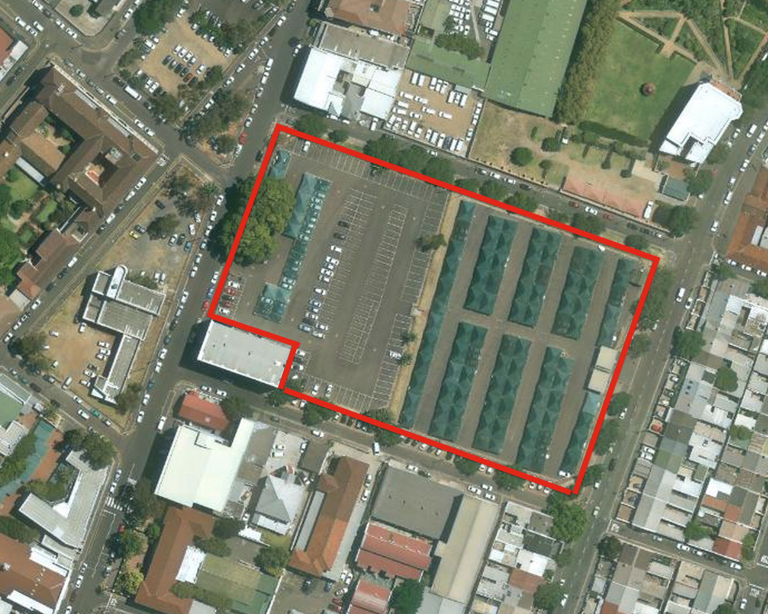
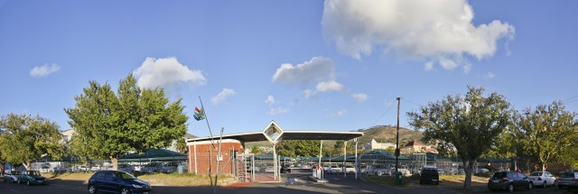
Top Yard
New Life in the east CBD
Vacant Possession
Two users on the site
    Government Motor Transport (GMT)
    National Public Works
A relocation site acquired to enable vacant possession of Top Yard
Expected to be vacant by Q3 2015
Parking facility provides interim use opportunity if required (440 bays)
Notes:
GMT & National.
Engagement has started with both.
There is a strong relation plan .
Acquisition of Rusper Street.

Slide 9

Top Yard
New Life in the east CBD
Summary
Development site - prime position & development rights in place
Vacant possession by Q3 2015
DTPW open to market feedback to create a commercially viable transaction
Precinct planning to be complete by Q2 2014
No EIA required
Thank You

