Slide 1
Chapman’s Peak Drive
Operations Centre and Toll Plaza
March 2012

Slide 2
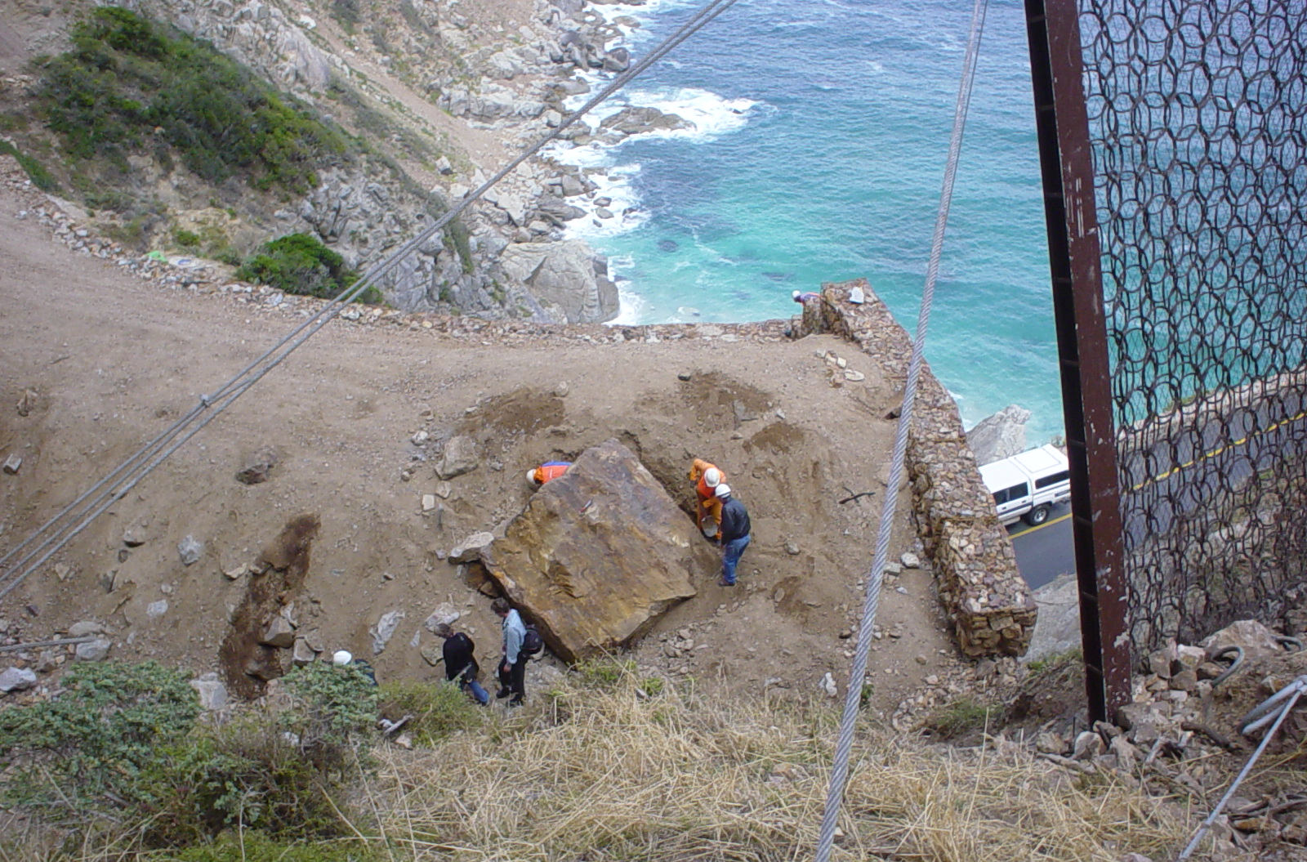
Chapman’s Peak Drive
25 Ton Boulder on Half-Tunnel 2004

Slide 3
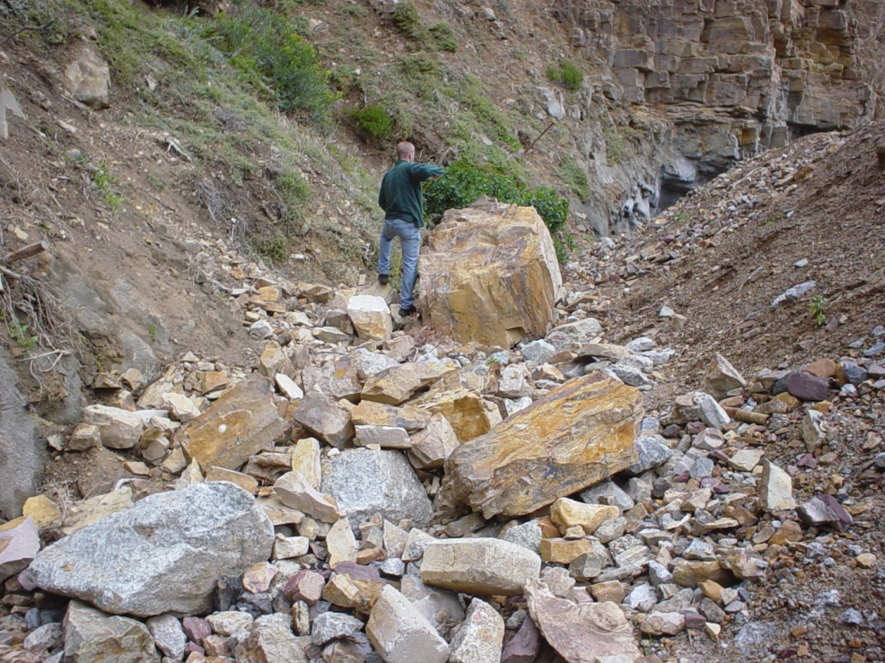
Chapman’s Peak Drive
Top of Half-Tunnel Showing Various Rockfalls

Slide 4
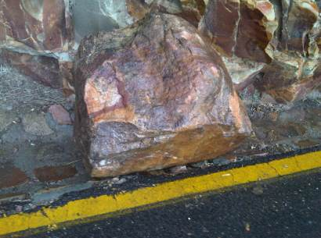
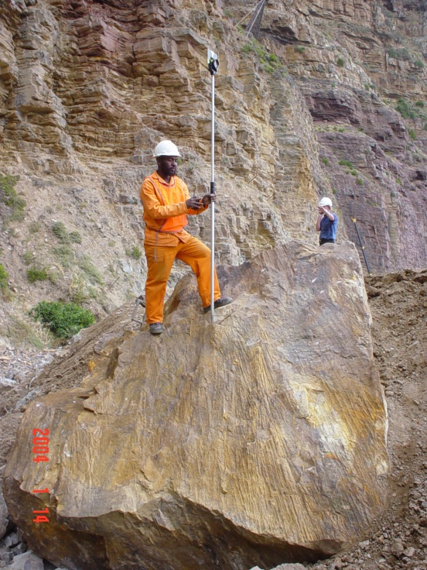
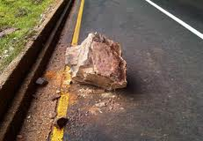
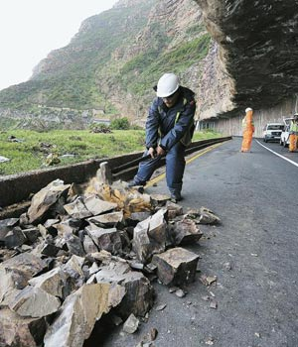
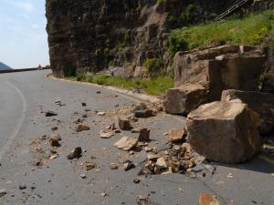
Chapman’s Peak Drive
25 Ton Boulder and Various Rockfalls

Slide 5
Chapman’s Peak Drive
Without tolling, Chapman’s Peak Drive will be permanently closed.
Due process has been followed from the beginning, including an extensive public participation and appeals process spanning eight years.
The SANParks land involved is in fact 0.022% of 970 hectares sold by Province to SANParks in 2003 for R1200.
The operations centre and toll plaza is vital to the operations and safety needed to manage Chapman’s Peak Drive as a whole and which replaces unacceptable temporary working conditions.
Day passes will continue provided permanent tolling facilities are introduced.

Slide 6
Background
1922 Chapman’s Peak Opened
No records kept of rockfalls, landslides and washaways.
Known serious rockfalls and landslides (one or more fatality or serious injury):
  August 1977, July 1987, July 1993, August 1993, June 1994
May 1980, road closed for seven months after portion washed away
Jan 2000, Lara Callige killed and Olga Callige critically injured by rockfall in good weather conditions.

Slide 7
Background
After Callige sisters, road was to stay closed from 2000 – 2003
Decision was taken to toll the road and to appoint a concessionaire to rehabilitate the road and then toll it.
Entilini were appointed via a competitive bidding process.
Entilini obtained R160M loan to rehabilitate the pass.
Used a combination of safety features, including catch-fences, netting, barring down, a half-tunnel at the most dangerous point, and a comprehensive monitoring system involving CCTV, tremor and weather detection systems.

Slide 8
Due Process
2002 Objections were made to early toll plaza plans and a full EIA process began
2003 The EIA included a major public participation process
  The draft plans for the toll plaza(s) were first made available to the public in 2003 as part of the public participation process.
  Ads were placed in the Sunday Times and Rapport (8 June 2003), the Cape Times and Die Burger (5 June 2003), False Bay Echo and Constantiaberg Bulletin (12 June 2003) and Hout Bay Sentinel (13 June 2003) inviting Interested and Affected Parties (IAPs) to register and provide comment.
  Public Notices were erected at various locations in the surrounding areas and at either end of Chapman’s Peak Drive, announcing public meetings and inviting IAPs to register.
  Public meetings were held at Fish Hoek (18 June, 30 July), Hout Bay (19 June, 31 July) and with Chapman’s Peak Community Forum on 2 August 2003.
  A site visit was conducted with the Chapman’s Peak Drive Environmental Monitoring Committee on 10 July 2003.
  The EIA was lodged at the affected public libraries and posted online, and IAPs invited to comment further.

Slide 9
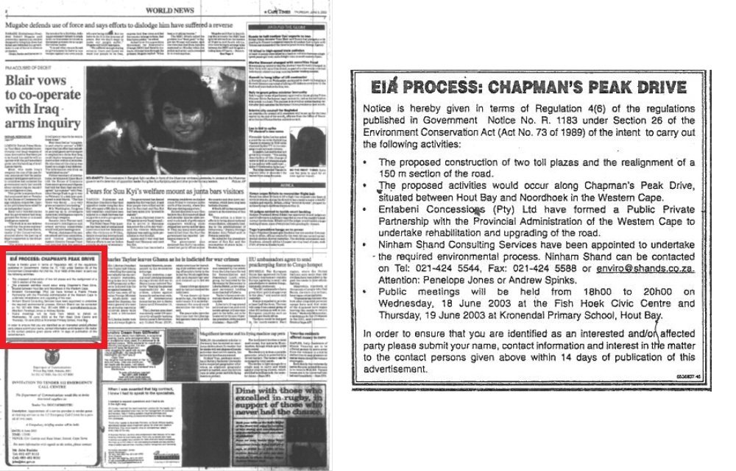
Due Process
Cape Times, page 2, 5 June 2003

Slide 10
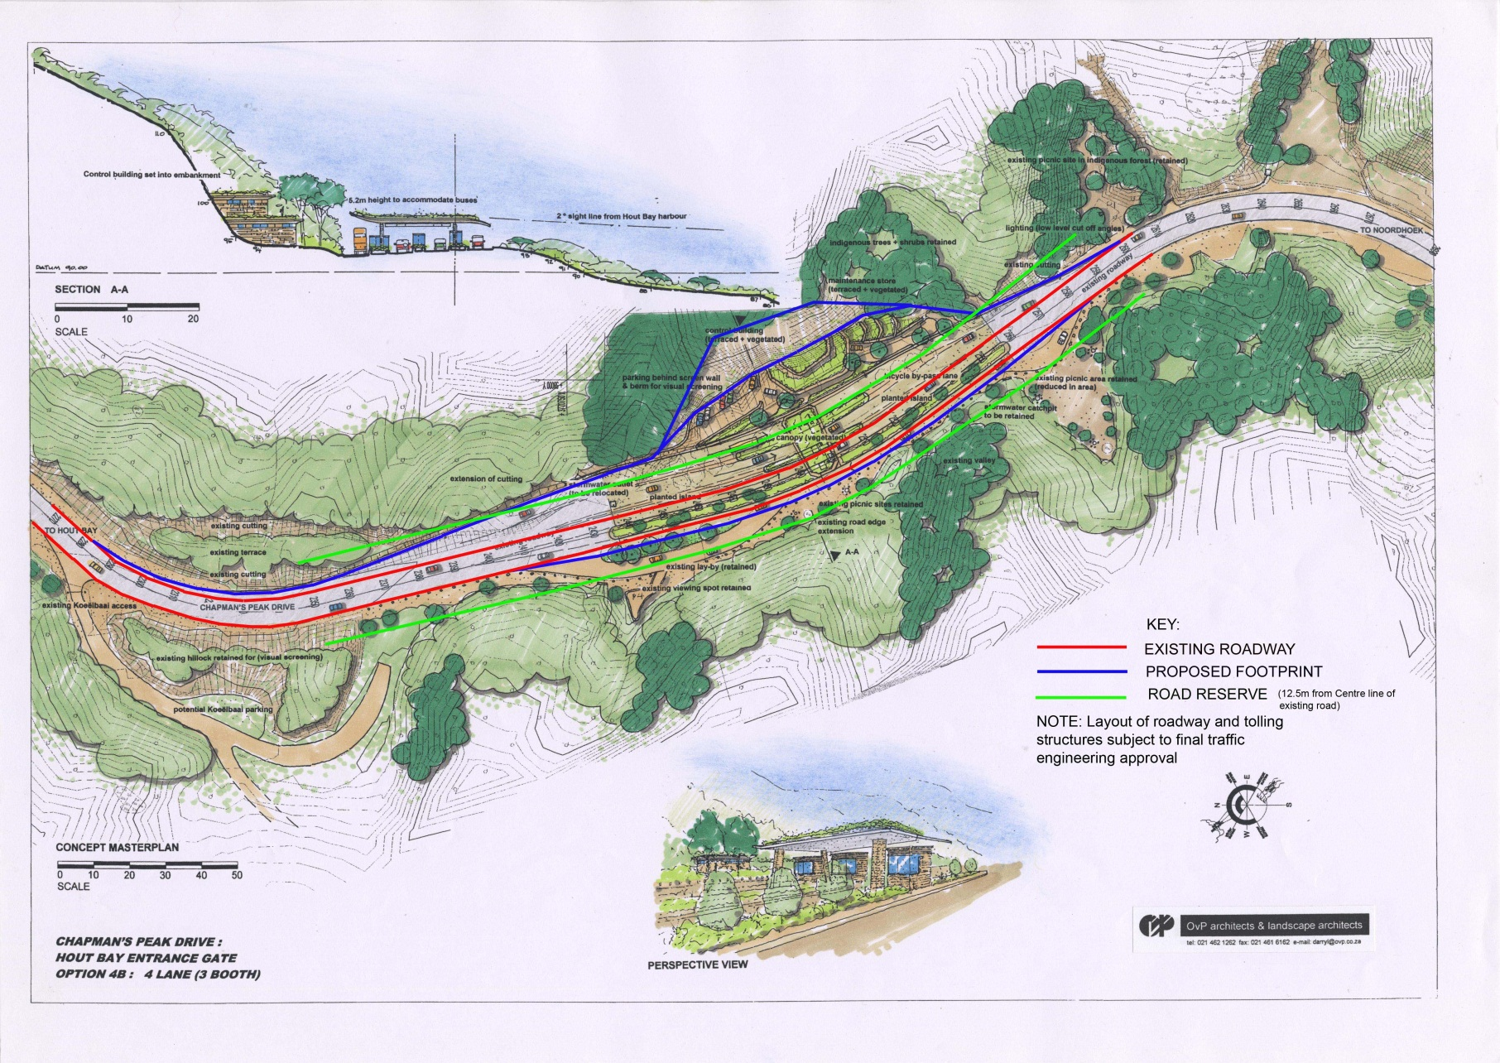
Due Process
Plans Released During Public Participation Process

Slide 11
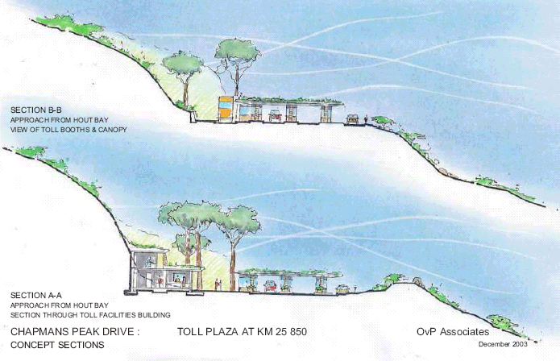
Due Process
Plans Released During Public Participation Process
Inset: 2008 Final design

Slide 12
Due Process
2005 Record of Decision issued in favour of construction of two toll plazas.
ROD was challenged.
2008 Appeal Record of Decision issued by then Environment Minister Marthinus van Schalkwyk, upheld 2005 ROD.
2009 Report reveals no irregularity in concession contract but considerable tension over delays and lengthy closures (which Province had to pay for)
2009 – 2011 Contract renegotiated
2011 Third Amending Agreement signed, removing paid-for closure

Slide 13
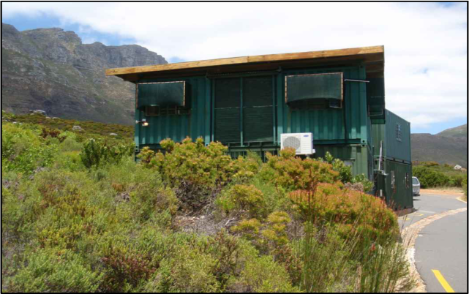
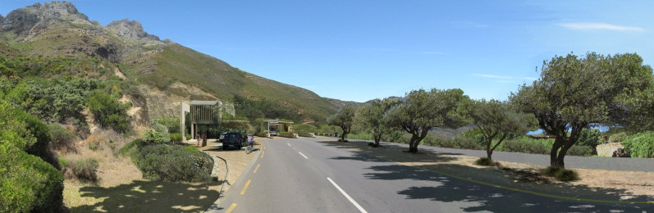
The Toll Plaza and Control Centre
2008 Final design of the toll plaza and control centre was completed:
  Based on environmental principles developed specially for building on Chapman’s Peak
  Based on practical experience of the concessionaire running the toll operation over the previous 5 years, since 2003.
Old and New: Temporary Facilities and 3D Model of New Design

Slide 14
The Toll Plaza and Control Centre
New building to replace temporary facilities:
Stack of six shipping containers and four fibreglass toll booths
Port-a-loo toilets in use by staff for eight years
As many as 200 staff departures since 2003, often citing poor working conditions
June 2010, female toll booth operator severely beaten by criminals in one of four robberies of the temporary facilities
New building described as “luxury office block” in the media:
Largest office is that of Entilini General Manager at 12.4m², or roughly the size of a 16 seater minibus.

Slide 15
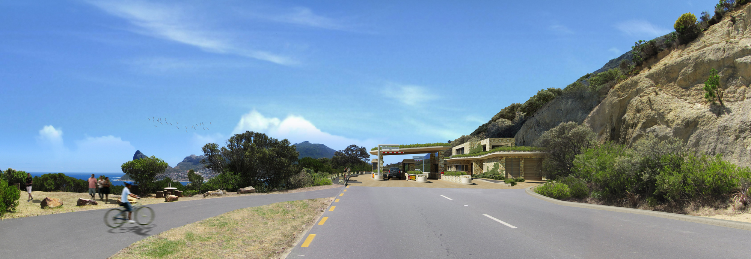
The Toll Plaza and Control Centre

Slide 16
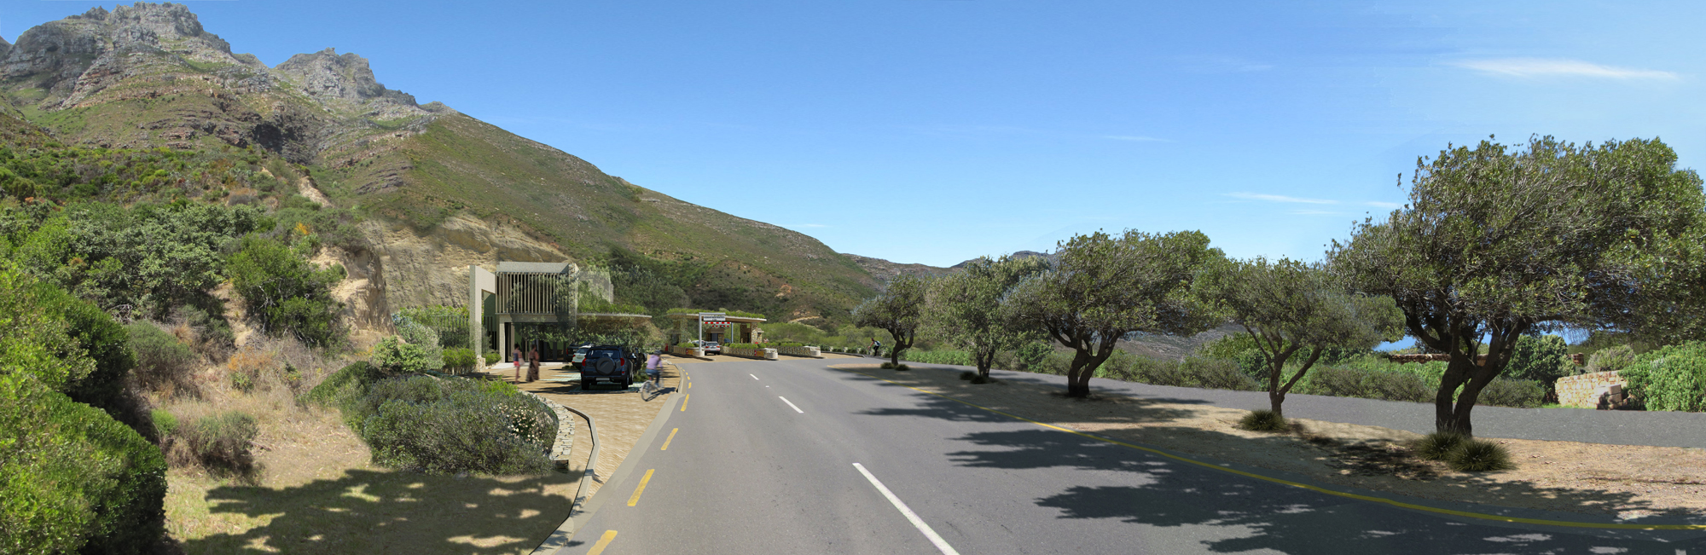
The Toll Plaza and Control Centre

Slide 17
Location of Toll Plaza
Located in disused quarry above Koeelbaai with low environmental value
Across the road from Tintswalo Atlantic luxury hotel
2.5km from Hout Bay
Is not visible or audible from Hout Bay
Close as possible to most dangerous parts of pass, without being at risk, critical for emergency management
Control centre will be located on 2100m² of land which formerly belonged to SANParks
Land was originally given to SANParks by Province in 2003 as part of 9,700,000m² transfer, then re-incorporated into Provincial road reserve in 2011.

Slide 18
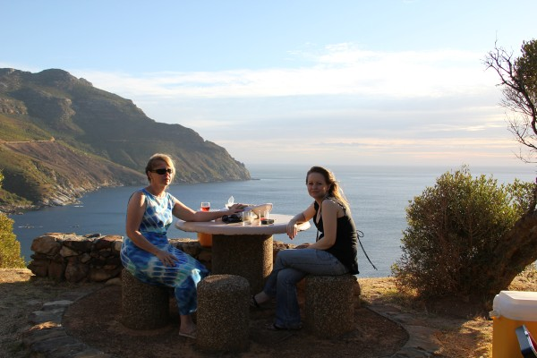
Day Pass System
Province will continue to subsidise the Day Pass System
Wild Card holders will continue to get discounted access
Access to picknicking, hiking and lookout facilities on either side of the toll plaza will remain

