Slide 1
SUPPLY CHAIN MANAGEMENT:
CFO FORUM MEETING
6 SEPTEMBER 2013

Slide 2
SUPPLY CHAIN MANAGEMENT
Introduction
The 2nd quarterly SCM Forum for 2013 /14 Financial year was held on 16 August 2013 in Worcester.
The institutions listed below were invited and made presentations on the identified topics.
National Treasury
Updates from the Office of the Chief Procurement Officer.
  Proper platform for SCM.
Revision of the Legislative Framework for SCM.
Address critical SCM areas Regulations 32, 36, MFMA section 33 etc.
Training and capacity programmes.
Department of Trade and Industry
Updates in terms of the codes of good practice and discussion on the relevant changes.
Update on designated sectors for local content.
Procedures for suppliers
Completion of all documentation for suppliers
Discussion regarding all the problem areas
Proposal from the forum was that the DTI issue Local Content Certificates to suppliers

Slide 3
SUPPLY CHAIN MANAGEMENT
CIDB
Presentation on Revised CIDB Regulations.
Changes made to stimulate the market and provide more business opportunities.
AUDITOR –GENERAL
Presentation by AG on SCM audit outcomes and focus for the current audit.
SABS
Presentation by SABS on local content verifications and initiatives
Provincial Local Content Task Team was established to address all concerns with NT and DTI

Slide 4
Documents for calculation of Local Content
Standard bidding document (SBD / MBD 6.2)
Latest version published by the National Treasury
Should forms part of the bid document for all designated products
http://www.treasury.gov.za/divisions/sf/sc/default.aspx
SATS 1286: 2011 (SABS technical specification)
Standard approach for the calculation of local content
Can be downloaded from http://www.thedti.gov.za/industrial_development/ip.jsp
Guidance document for calculation of local content
Can be downloaded from http://www.thedti.gov.za/industrial_development/ip.jsp

Slide 5


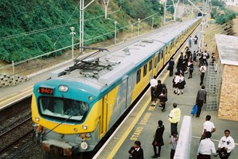

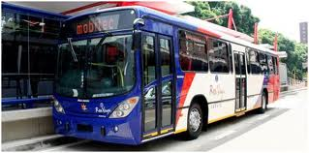

Designated sectors

Slide 6
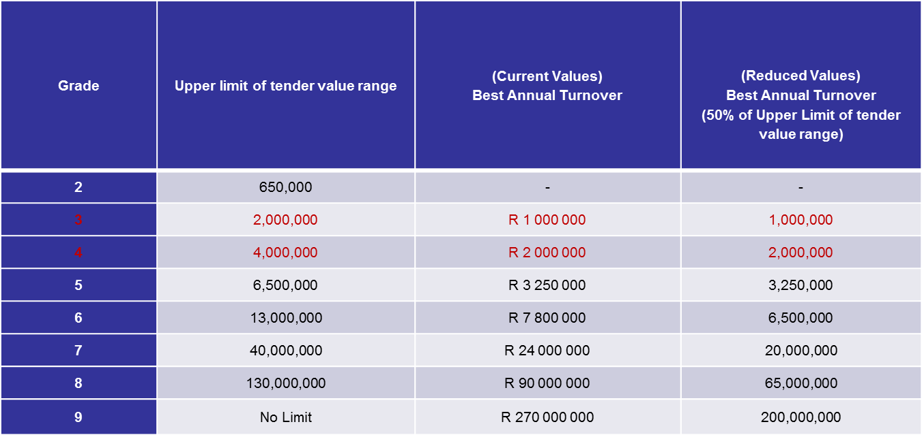
CIDB Amendments – Annual Turnover

Slide 7
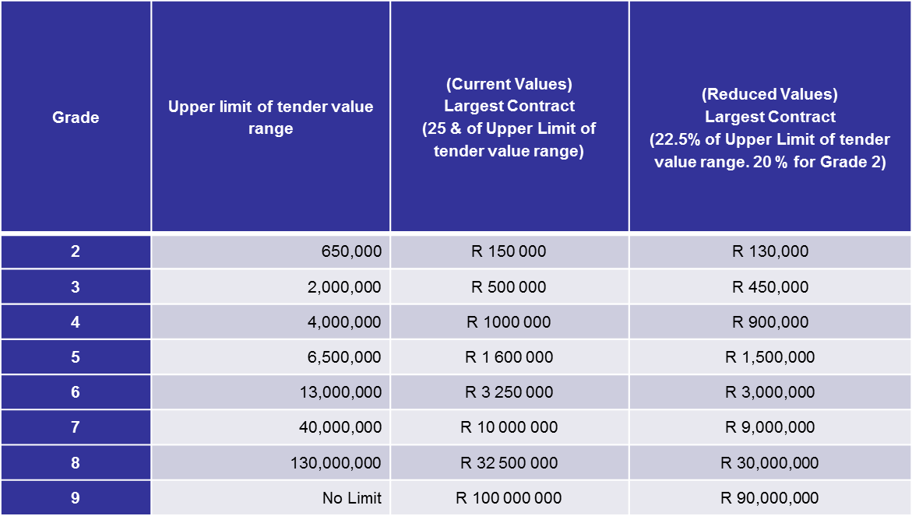
Amendments – Largest Contract (Track Record)

Slide 8

^{SCM audit report findings}
10

Slide 9


LOCAL CONTENT VERIFICATION PROCESS FLOW
VERIFICATION AUDIT CONDUCTED IN TWO PARTS:
  VERIFICATION OF THE DOCUMENTATION TO ENSURE LOCAL CONTENT IS AS PER THE DESIGNATED REQUIREMENT.
  FACTORY SHOP FLOOR TECHNICAL VERIFICATION OF THE LOCAL CONTENT AS DESCRIBED IN THE DOCUMENTATION VERIFIED ABOVE
THE AUDIT WILL CONSIST OF AT LEAST TWO TIERS AT THE FINAL ASSEMBLY LEVEL AND SUB-ASSEMBLY LEVEL DEPENDING ON THE DISCUSSIONS WITH the dti OR RELEVANT STATE ORGANISATION.

Slide 10

CURRENT PROJECTS
TRAINING OF PROCUREMENT OFFICERS – ECONOMIC DEVELOPMENT GAUTENG & ESKOM SUPPLIER DEVELOPMENT & LOCALISATION TEAM.
WORKSHOPS WITH TRANSNET FOR ROLLING STOCK SECTORS
PLANNING WORKSHOPS FOR THE SOLAR WATER HEATER SECTOR VIA ESKOM
LOCAL CONTENT VERFICATION PROCESS SCOPING COMPLETED FOR BUS BODIES – BRT JOHANNESBURG
LOCAL CONTENT VERFICATION PROCESS SCOPING COMPLETED FOR TEXTILE SECTORS
VOLUNTARY LOCAL CONTENT VERIFICATION EXPLORED WITH PRIVATE SECTOR ON NON-DESIGNATED PRODUCTS

Slide 11
THANK YOU

