Slide 1
Overview of the vaccines

Slide 2
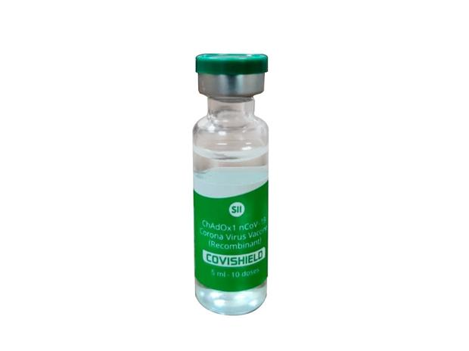
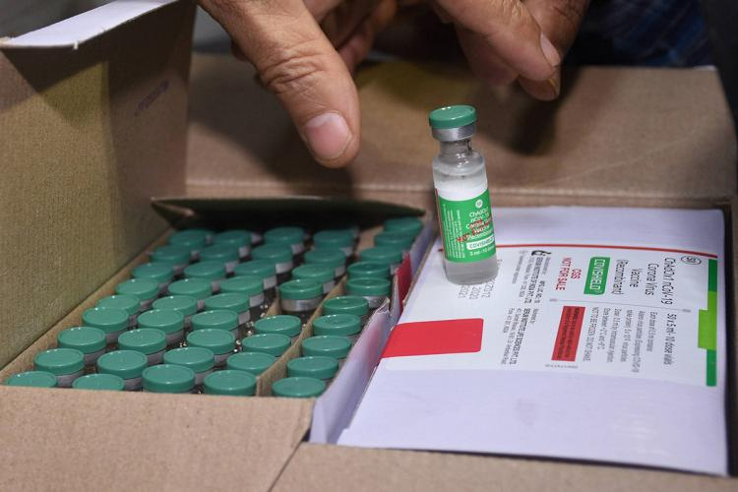
Aztra Zeneca Vaccine
Trade name: SII product called COVISHIELD
Technology: Viral Vector (Genetically Modified Version)
Efficacy: 62%-90% (different trails)
Number of doses required: 2
Dose interval: 4-12 weeks (12 weeks recommended
by the MAC)
Administered in the Deltoid muscle with needle/syringe
Fully liquid vaccine
Storage: 2-8°C
Side-effects: Mild to moderate in severity and usually resolve
within a few days of vaccination injection site tenderness;
injection site pain, headache, fatigue; myalgia, malaise; pyrexia,
chills; and arthralgia, nausea

Slide 3
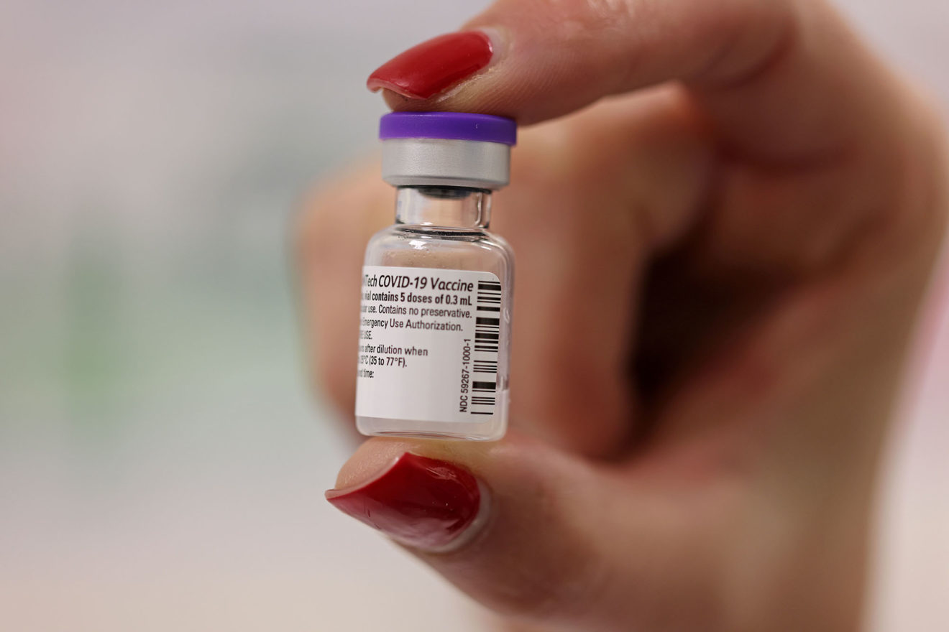
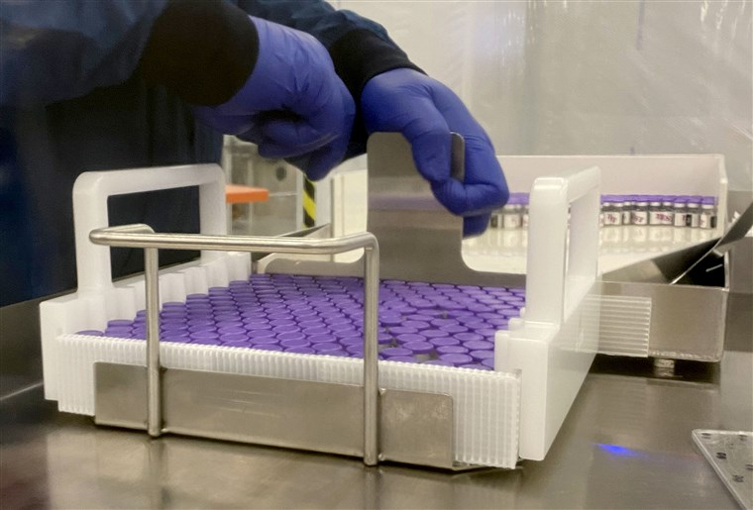
Pfizer Vaccine
Technology: mRNA
Efficacy: 95%
Number of doses required: 2
Dose interval: 21 days apart
Administered in the Deltoid muscle with needle/syringe
Vaccine require reconstitution
Storage: -70°C during storage and distribution, at vaccination site
could be stored at 2-8°C for 120 hours
Side-effects: Side effects (such as fever, chills, tiredness, and
headache) throughout the body were more common after the
second dose of the vaccine. Most side effects were mild to
moderate.
Allergic reaction could occur within 4 hours of
getting vaccinated, including symptoms such as hives, swelling,
or wheezing (respiratory distress).
This includes allergic reactions to polyethylene glycol (PEG) and
polysorbate

Slide 4
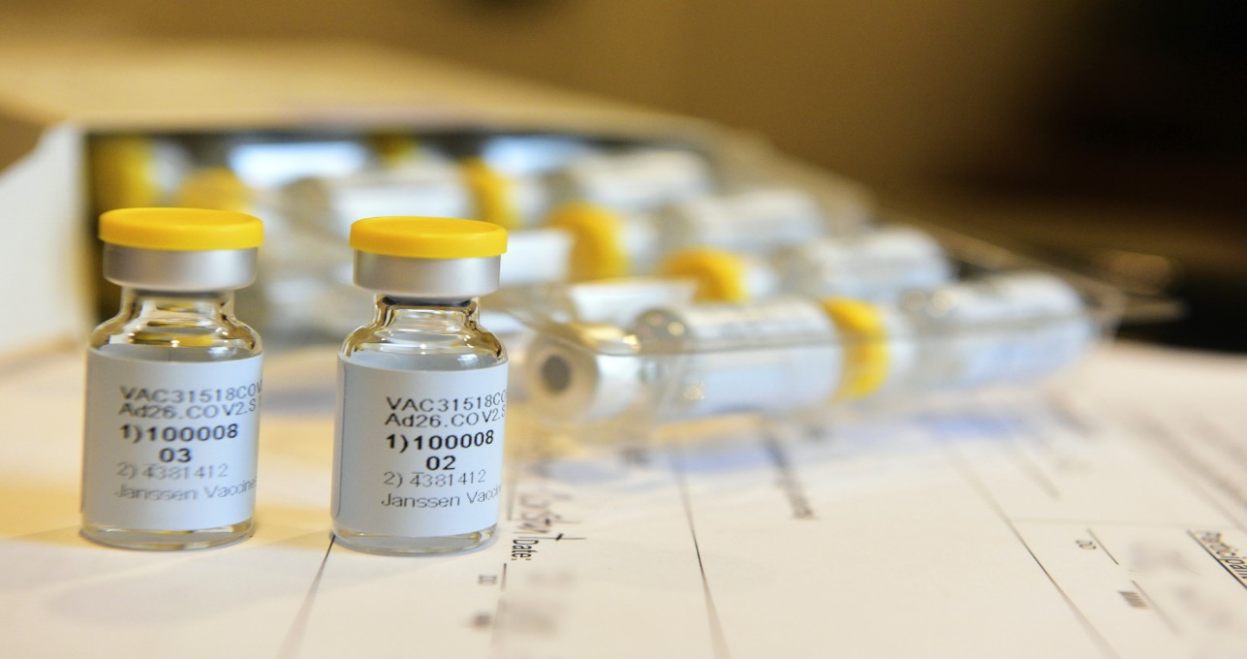
J&J Vaccine
Technology: Ad26 Viral vector vaccine
Efficacy: Currently in phase III -Target efficacy 70%
Number of doses required: 1
Administered in the Deltoid muscle with needle/syringe
Fully liquid vaccine
Storage: 2-8°C
Side-effects: Initial safety information released for the vaccine shows that the most common reactions after the vaccine was administered included: Injection site pain, Fatigue, Headache, Muscle aches.
Phase III clinical trail in progress

Slide 5
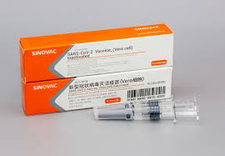
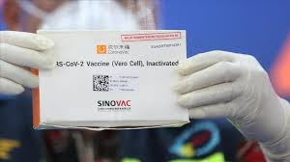
Sinovac Vaccine
Technology: Inactivated vaccine
Efficacy: 50%-70% (different trial results)
Number of doses required: 2
Dose interval: 14 day interval
Administered in the Deltoid muscle with needle/syringe
Fully liquid vaccine
Storage: 2-8°C
Side-effects: Most adverse reactions were mild, with the most
common symptom being injection-site pain

Slide 6
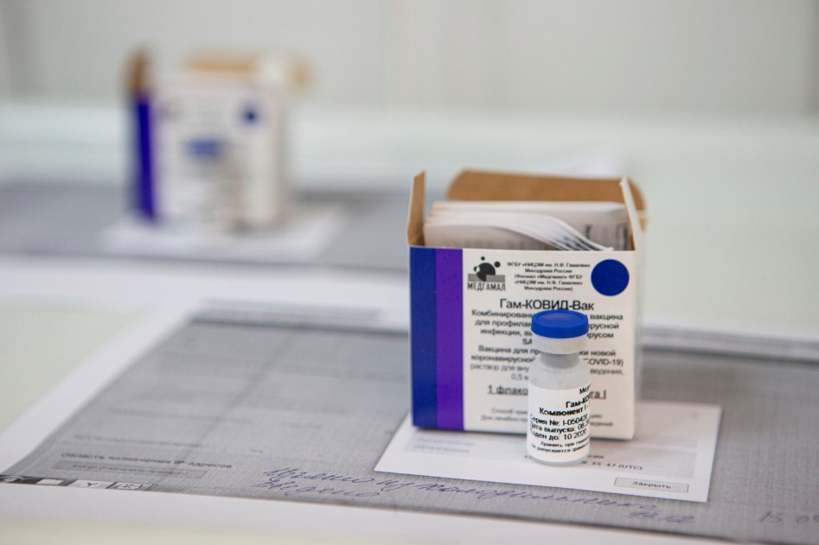
Sputnik V Vaccine
Technology: Adenoviral vector vaccine
Efficacy: 92%
Number of doses required: 2
Dose interval: 21 day interval
Administered in the Deltoid muscle with needle/syringe
Reconstitution required
Storage: 2-8°C (freeze dried) require diluent
Side-effects: Most adverse reactions were mild, include a
fever of 38°C, headaches and muscle pain

Slide 7
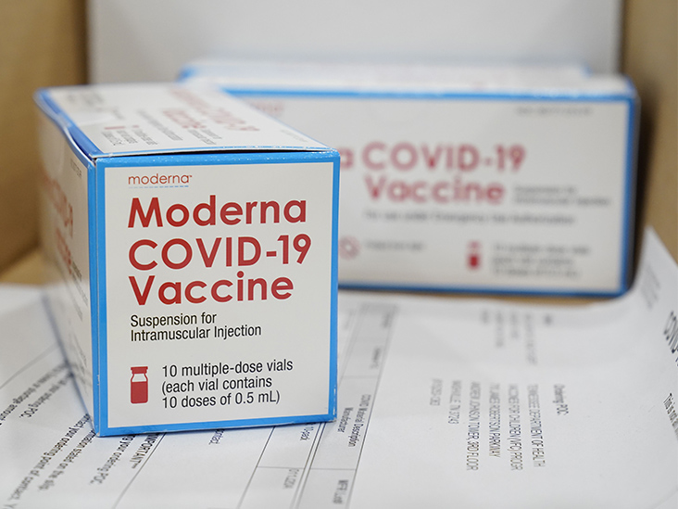
Moderna Vaccine
Technology: mRNA
Efficacy: 94.5%
Number of doses required: 2
Dose interval: 28 day interval
Administered in the Deltoid muscle with needle/syringe
Fully liquid
Storage: -20°C distribution storage at vaccination site
could be stored at 2-8°C for 30 days
Side-effects: Side effects (such as fever, chills, tiredness, and
headache) throughout the body were more common after the
second dose of the vaccine. Most side effects were mild to moderate.
Allergic reaction could occur within 4 hours of
getting vaccinated, including symptoms such as hives, swelling,
or wheezing (respiratory distress).
This includes allergic reactions to polyethylene glycol (PEG) and
polysorbate

