Slide 1
EVDS - Self Enrollment Portal
27 January 2020

Slide 2
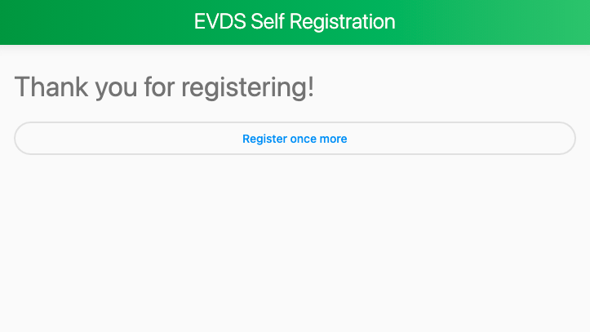
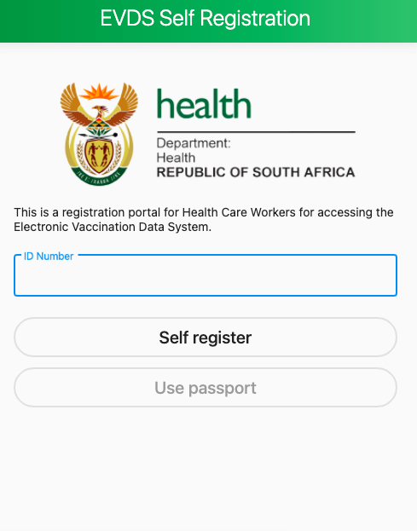
Online Vaccine Self Regsitration for Healthcare Workers

Slide 3
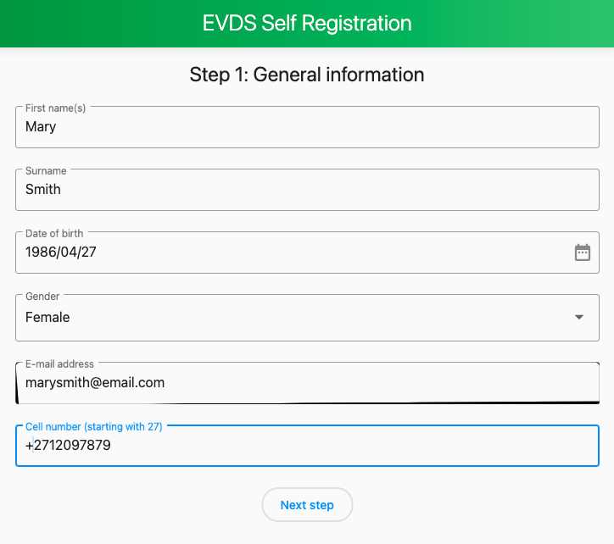
Overview of information requirements
In order to receive a vaccination appointment, individuals will be required to register using the online portal.
Individuals will submit general information, as well as information about their place of work.
This will be used to match them to a registered vaccination service point when the vaccine is allocated.
Information provided on the portal will also be used to communicate with individuals about the vaccination program when necessary, through this application.
All healthcare workers, public, private, clinical and non- clinical should register online on this platform

Slide 4
Health Care Worker Enrollment and Booking System:
1
HCW Enrollment
3
Vaccinnee Registration
4
Vaccinnee Confirmation & Consent
The HCW Vaccinee gets an SMS presents to the Vaccine Ste Registration Desk with ID book and Medical Aid details and Vaccination Code included in the SMS .
The vaccinator confirms that the person is elegible
2
Notifications sent to all beneficiaries as to whare, date and time to receive Vaccination
Vaccinnee Administration and Data Capture on EVDS
6
5
The process is complete
The vaccinator administer the vaccine, captures the required info on EVDS – record the Vaccination Code . The HCW will receiuve a message that they received the 1st dose of the Vaccine and schedules the dose for the 2nd dose appointment
EVDS Notification System
EVDS Vaccine Administration

Slide 5
How will you know when portal is live
There will be extensive communication to inform Health Care Workers through different platforms and Mechanisms
Social Media
Professional Organisations
HCW Employers
Labour Unions

